Slide 1
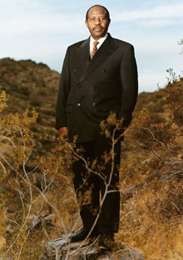
An Ordinary Man an autobiography of the Rwandan genocide by Paul Rusesabagina

Slide 2
STOP and WRITE:
What do you know
about the role of the United Nations in the Rwandan genocide?

Slide 3

Rwanda
Land of a thousand hills

Slide 4
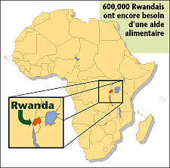
Rwanda continued

Slide 5
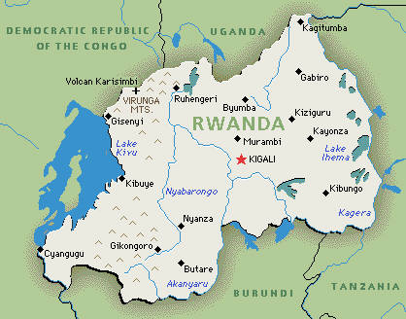
Rwanda Map

Slide 6
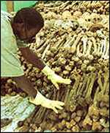
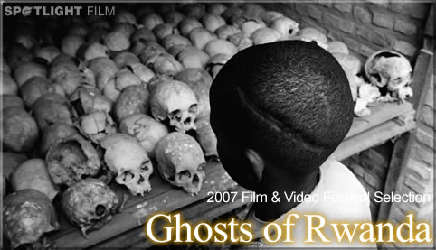
Who: Hutus & Tutsis
What: racial hatred & genocide
When: April 1994, 100 days
Where: Rwanda; capital city, Kigali
Why: power; blind conformity

Slide 7
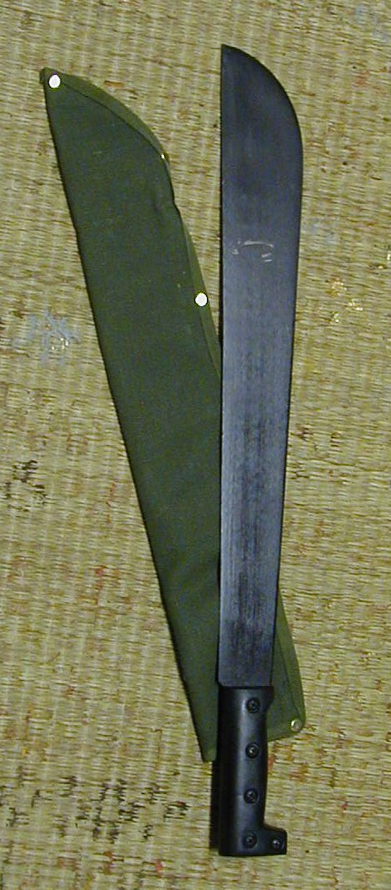
Massacre through Machetes
“Peter was a cool guy…very gentle, kind of a kidder…I saw him that morning…holding a machete dripping in blood…The entire world had gone mad around me” (xiv).

Slide 8
STOP & WRITE:
What other genocides (at least two) do you know of in history? What was the rationale given by the murderers behind the mass killings? What was the method of extermination?

Slide 9
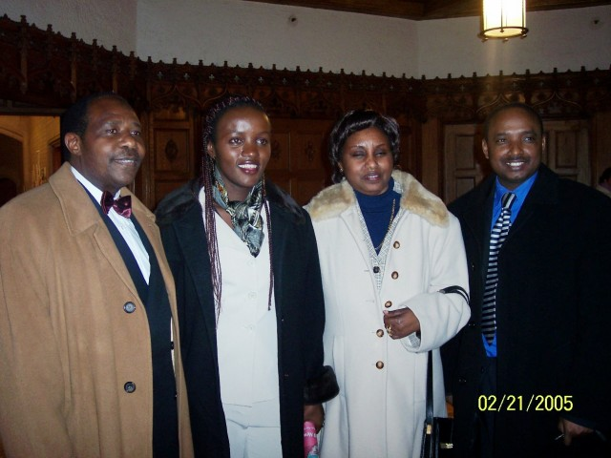
Paul’s Family Today: political asylum in Belgium

Slide 10
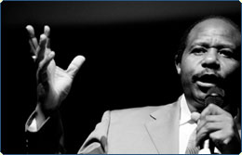
Paul: “It frightens me to death when my countrymen are not talking.”

Slide 11
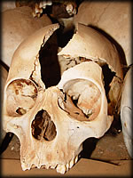
“NEVER AGAIN.”

Slide 12
STOP & WRITE:
What can YOU do to stop present-day and future genocides? Explain at least three steps you can take to help.

Slide 13
Homework
http://www.un.org/preventgenocide/rwanda/support.shtml
Go to the above website, “Lessons from Rwanda, The United Nations and the Prevention of Genocide” fact sheet—read the links, “Supporting Survivors” and “Discussion Guide” on the left tab.
Write a reflection with five new things you learned or have a reaction to...this reflection should be one page, typed and double-spaced.

Slide 14
Upcoming Online Activity:
Go to: The Center for Human Rights http://www.wcl.american.edu/humright/center/rwanda/lesson.cfm
Collaborative grouping: Hutus & Tutsis; Valentina’s story; International Community’s Response; Post-Genocide Rwanda

Slide 15
Post-Novel Activity:
Go to: The Center for Human Rights
http://www.wcl.american.edu/humright/center/rwanda/lesson.cfm
Read and discuss “Student Activism”
Write a persuasive letter to Senator Bayh, Senator Lugar, or another politician of your choice urging action to be taken in the Sudan, Africa.

Slide 16
Field Trip:
We will travel to Bloomington, Indiana and meet with Dr. Osita Ofoaku at Indiana University’s West African Studies Center.
We will engage and participate in a two-hour workshop on the Rwandan genocide and the post-genocidal culture of Rwanda.
Please prepare three questions to ask Dr. Ofoaku and his graduate students regarding African traditions and modern Africa.

