Slide 1
Dublin
Irish Eyes: A Look
at a Few of the Landmarks
In One of Ireland’s Oldest Cities

Slide 2
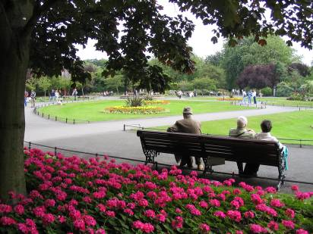
St. Stephen’s Green

Slide 3
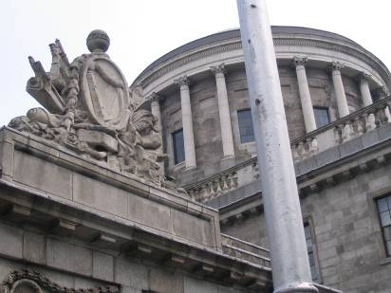
Parliament Building

Slide 4
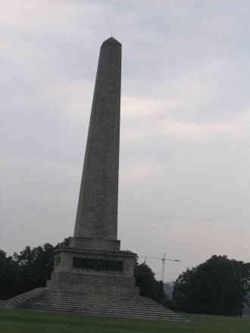
The Wellington Monument

Slide 5
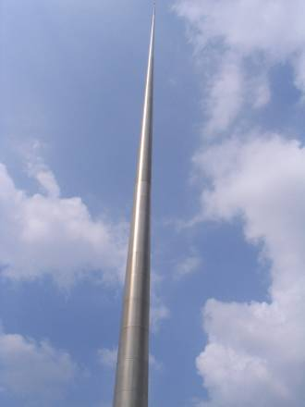
The Millennium Spire

Slide 6
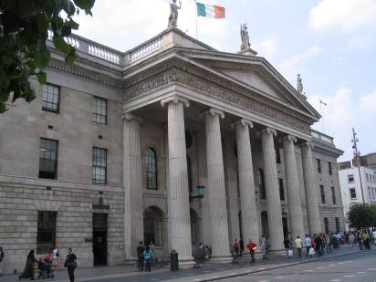
The Post Office

Slide 7
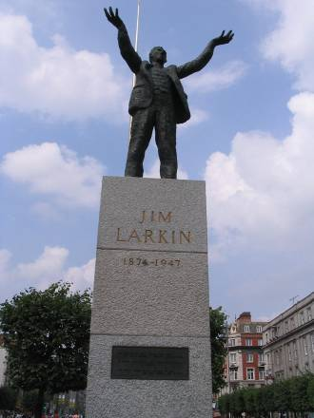
Jim Larkin Monument

Slide 8
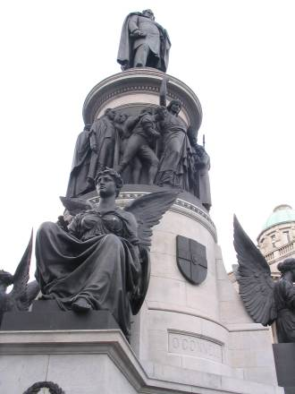
Daniel O’Connell

Slide 9
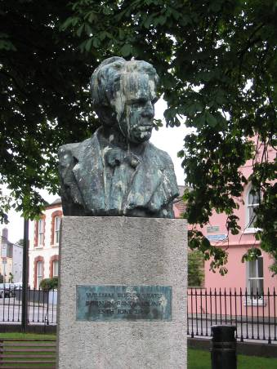
W.B. Yeats’ Bust in Sandymount

Slide 10
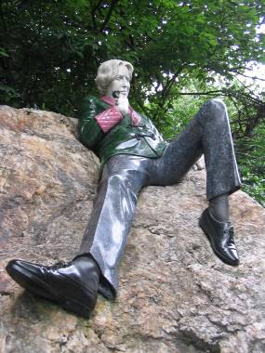
Oscar Wilde Statue in Merrion Square

Slide 11
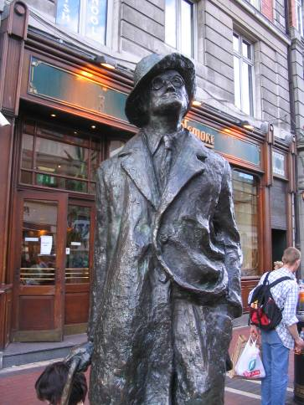
James Joyce Statue

Slide 12
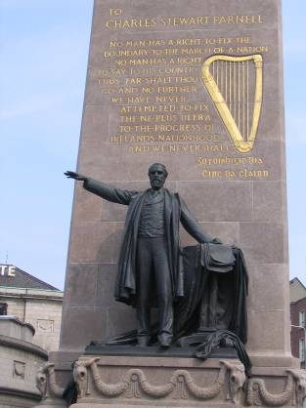
Charles Stewart Parnell

