Slide 1
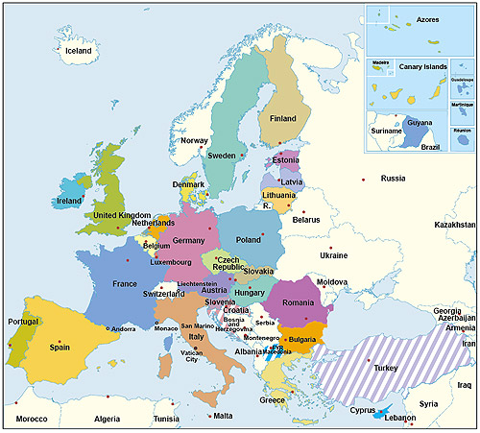
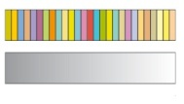
The European Union:
493 million people – 27 countries
Member states of the European Union
Candidate countries
Notes:
This is a current map of the European Union (EU). Not all countries in Europe are part of the EU.

Slide 2
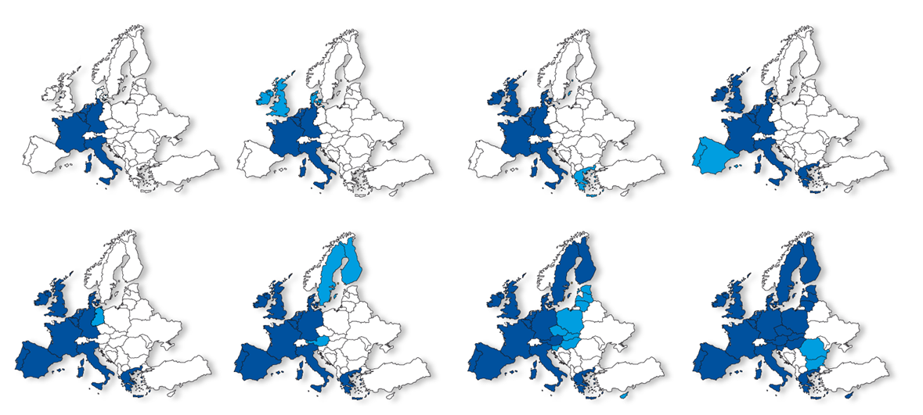
Eight enlargements
1952
1973
1981
1986
1990
1995
2004
2007
Notes:
The European Union was not always as large as it is today, having expanded several times.
Question: What trends do you notice about the growth of the European Union?
Answer: Notice that the EU began in Western Europe, in countries that were considered democracies and were generally allied against communism and the Soviet Union. No country that was part of the Eastern/Soviet Bloc came into the EU until a few years after the Soviet Union collapsed in 1991.

Slide 3
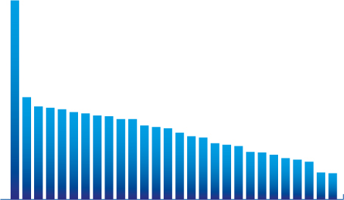
GDP per inhabitant: the spread of wealth
GDP per inhabitants in Purchasing Power Standards, 2007
Index where the average of the 27 EU-countries is 100
280
144
131
129
127
123
121
118
117
113
113
104
102
100
94
89
87
79
77
75
67
66
63
58
56
53
38
37
Ireland
Sweden
Malta
Portugal
Estonia
Hungary
Austria
Finland
France
Slovakia
Poland
Latvia
Romania
Spain
Bulgaria
Italy
EU-27
Cyprus
Belgium
Germany
Greece
Luxembourg
Denmark
Slovenia
Lithuania
Netherlands
United Kingdom
Czech Republic
Notes:
This slide helps students understand the economic difference between the democracies/demand economies of Western Europe and the communist.command economies of Eastern Europe.
[Check that stidents understand command and demand ecomies
]
Question: Do you see any pattern in the information shown on this slide relating to communism and command economies?
Hint: Find the EU GDP average, then look at the country names on each side.
Answer: Every former communist country is below the EU average. In fact, at the time of the collapse of the Soviet Union, the poorest country in Western Europe had a higher GDP than even the richest communist country! Note how things have been changing in our students lifetimes! This is not ancient history!

Slide 4
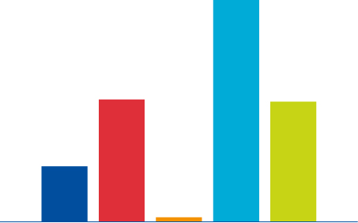
The area of the EU compared to the rest of the world
Surface area, 1 000 km²
16 889
9327
9159
4234
365
EU
China
Japan
Russia
United States
Notes:
Question: Percentage-wise, about how much smaller is the EU than either China or the US?
Answer: Note that the European Union, size-wise, is a little less than half the size of either China or the United States.

Slide 5
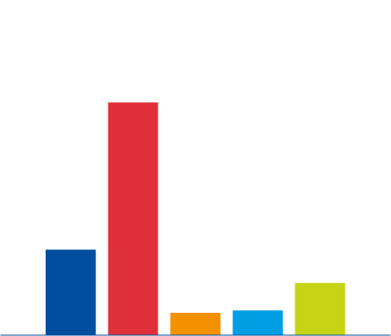
EU population in the world
Population in millions, 2007
1322
497
301
128
142
EU
China
Japan
Russia
United States
Notes:
Question: Percentage-wise, about how much larger is the EU population compared to the U.S.?
Answer: While the European Union is smaller physically, and has far fewer people than China, it does have a population 60% larger than the United States!

Slide 6
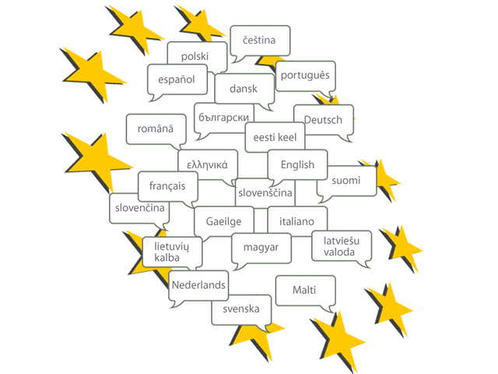
23 official languages
Notes:
So many countries—so many languages!
Question: What challenges do you think may result from this?
Answers will vary widely, but obviously communication issues are important.

Slide 7

Three pillars
The European Union
European Community domain (most of common policies)
Common foreign and security policy
Police and judicial cooperation in criminal matters
The Treaties
Notes:
The European Union has three major areas of cooperation—known as the three pillars.
The major focus of the first pillar is economic issues such as trade, jobs, money, etc., but some non-economic domestic issues are also acted upon in a cooperative fashion.
The second pillar focuses on developing common policies for dealing with non-EU members, and for expanding security cooperation against outside threats—including foreign terrorists.
The third pillar is about increased police cooperation. For instance, someone committing a crime in one country can’t expect to cross the border into a different EU country and get away with it. Also, police departments across Europe often share information about criminals and their activities.

Slide 8


The Court of Justice – upholding the law
27 independent judges,
one from each EU country
4Rules on how to interpret EU law
4Ensures EU laws are used in the same way in all EU countries
Notes:
The third pillar also includes common EU courts that decide cases dealing only with EU laws and regulations, but not the laws of individual countries.

Slide 9
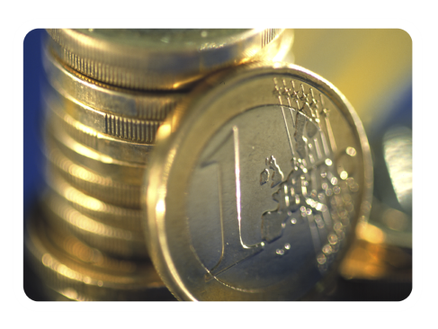
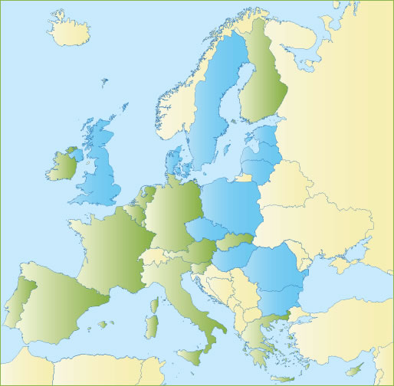
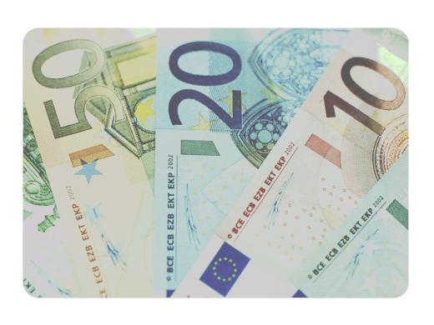
The euro – a single currency for Europeans
Can be used everywhere in the euro area
4Coins: one side with national symbols,
one side common
4Notes: no national side
EU countries using the euro
EU countries not using the euro
Notes:
Question: Can you name something dealing with the European economy that has happened since the EU was formed?
Answer: A common currency—the euro.

Slide 10
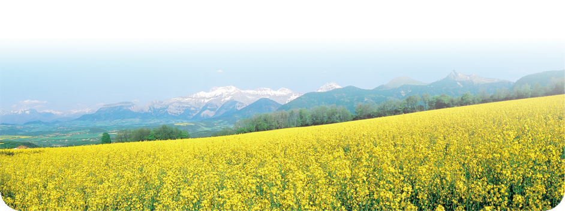
Improving health and the environment
Pollution knows no borders – joint action needed
EU action has helped bring us:
4 Cleaner bathing water
4 Much less acid rain
4 Lead-free petrol
4 Free and safe disposal of old electronic equipment
4 Strict rules on food safety from farm to fork
4 More organic and quality farming
4 More effective health warnings on cigarettes
4 Registration and control of all chemicals (REACH)
© Van Parys Media
Notes:
Here are other examples of how common policies have improved the quality of life for people in the EU.

Slide 11

Free to move
“Schengen”:
4 No police or customs checks at borders between most EU countries
4 Controls strengthened at EU external borders
4 More cooperation between police from different EU countries
4 You can buy and bring back any goods for personal use when you travel between EU countries
© Corbis
Notes:
At first, someone might think that the EU has made life more complicated and increased the number of regulations, but it has also simplified many things and offered individuals more freedom in certain areas.

Slide 12
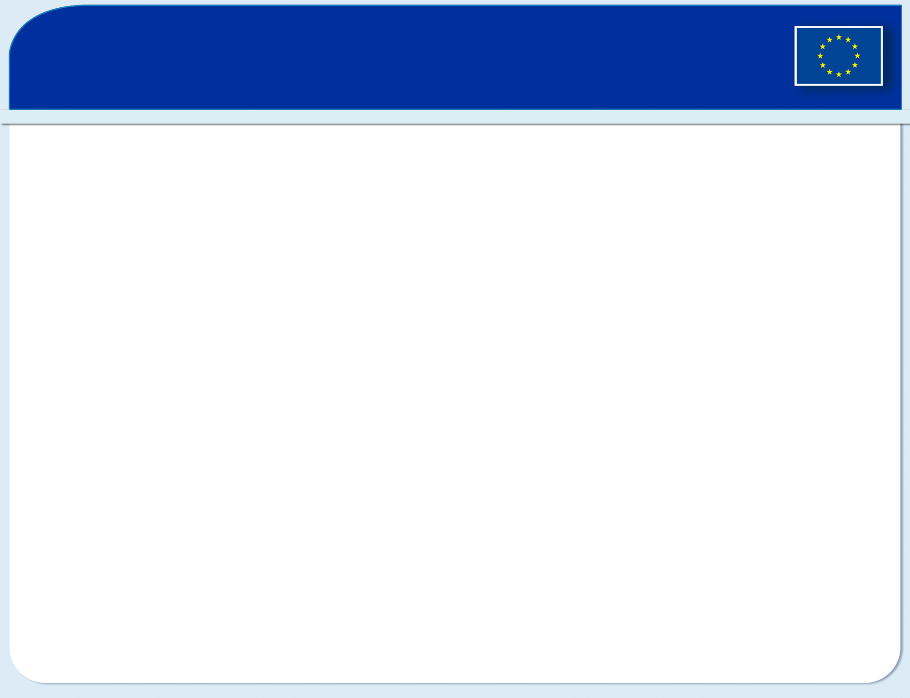
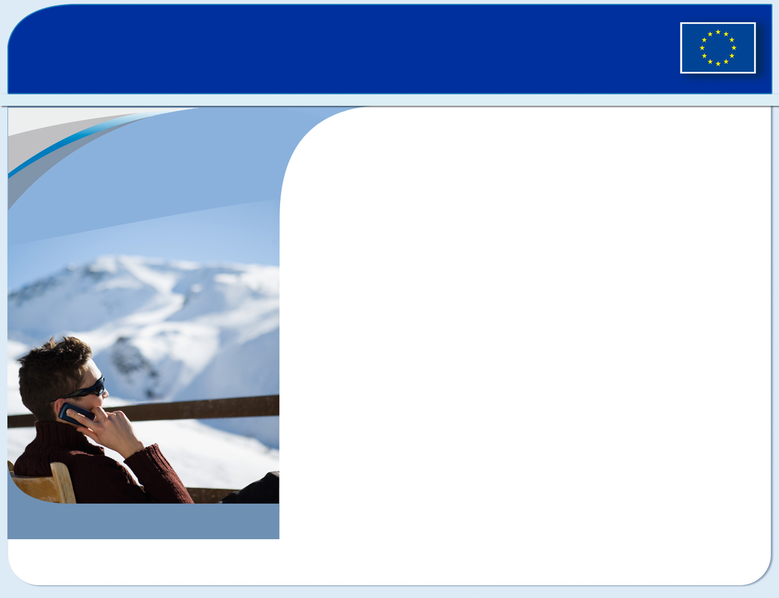

The single market: freedom of choice
Since 1993:
4 2.5 million new jobs
4 prices of phone calls
and airfares halved
Four freedoms of movement:
4 goods
4 services
4 people
4 capital
© Getty Images
Notes:
Here are four specific areas offering greater freedom due to EU cooperation.

Slide 13
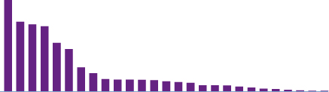
How many people live in the EU?
Population in millions, 2007
497 million
82.4
63.4
60.9
59.1
44.5
38.2
21.6
16.3
11.2
10.6
10.5
10.3
10.1
9.0
8.3
7.7
5.4
5.4
5.3
4.3
3.4
2.3
2.0
1.3
0.8
0.5
0.4
Italy
France
Spain
Germany
Poland
Greece
Belgium
Sweden
Denmark
Finland
Latvia
Estonia
Hungary
Slovakia
Malta
Netherlands
Bulgaria
Ireland
Luxemburg
Romania
Austria
Cyprus
Slovenia
United Kingdom
Portugal
Lithuania
Czech Republic
Notes:
This chart shows the population of the various EU countries.

Slide 14
The European Parliament – voice of the people
4 Decides EU laws and budget together with Council of Ministers
4 Democratic supervision of all the EU’s work
Number of members elected in each country
18
Finland
14
Latvia
Austria
9
Romania
35
Belgium
24
Lithuania
13
Slovakia
78
14
France
Bulgaria
Germany
6
18
99
Luxembourg
Slovenia
7
Cyprus
6
24
Greece
Malta
5
Spain
54
Czech Republic
Hungary
27
24
24
Netherlands
Sweden
19
Ireland
Denmark
13
Poland
54
78
14
United Kingdom
6
Italy
78
24
Estonia
Portugal
Total
785
Notes:
Question: The European Parliament is one of the law-making bodies of the EU. How do you suppose the number of members to be elected from each country is determined?
Hint: If students are having a hard time answering the question just go to the previous slide—but don’t say anything!
Another hint: If students think the size of country is the answer, then show side 15—otherwise skip it!
Answer: Determined by population of each country.
Explain that the Council of Ministers is another law-making unit of the EU with each country having one minister representing it.
Question: What does this information tell you about the type of government the EU has?
Answer: Democratic. The European Union requires all member countries to be governed by democratic principles.
Question: What American political institution resembles the European Parliament--and why?
Answer: The U.S. House of Representatives--because its members are chosen based on a state’s population.
Question: Which American political institution resembles the Council of Ministers--and why?
Answer: The U.S. Senate—because each state has the same number of senators as all the other states.

Slide 15
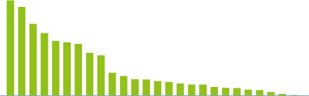
How big are the EU countries?
Surface area 1 000 km²
544.0
506.0
410.3
357.0
312.7
304.5
295.1
243.8
230.0
130.7
111.0
93.0
91.9
82.5
77.3
68.4
62.7
62.3
49.0
43.4
43.1
33.8
30.3
20.1
9.3
2.6
0.3
Spain
Italy
France
Poland
Sweden
Finland
Estonia
Germany
Greece
Latvia
Denmark
Hungary
Slovakia
Belgium
Malta
Bulgaria
Ireland
Netherlands
Luxemburg
Romania
Austria
Cyprus
United Kingdom
Portugal
Lithuania
Slovenia
Czech Republic
Notes:
This slide is not needed, but could be used in conjunction with the second hint from the notes for slide 14.

Slide 16
The European Union:
493 million people – 27 countries
Member states of the European Union
Candidate countries
Notes:
End of slide show for Lesson 2.

Slide 17
The European Union:
493 million people – 27 countries
Member states of the European Union
Candidate countries
Notes:
This begins the slide show for Lesson 3
.
Remind students that this is what the EU currently looks like.
Solicit student comments regarding what they learned yesterday during Lesson 2.

Slide 18

An area of freedom, security and justice
4 Charter of Fundamental Rights
4 Joint fight against terrorism
4 Police and law-enforcers from different countries cooperate
4 Coordinated asylum and immigration policies
4 Civil law cooperation
© European Union Police Mission
Notes:
Use this slide to reinforce examples of the Three Pillars of the European Union.
(Review slide 7 with class if desired)

Slide 19

Jobs and growth
Challenges:
4Demography: Europeans live longer, have fewer children
4Globalisation: European economy faces competition from other parts of the world
4Climate change: Emission of greenhouse gases must come down
Solutions:
European leaders have therefore agreed on a joint strategy for:
4More research and innovation
4A more dynamic business environment
4Investing in people
4A greener economy
Notes:
While the he European Union has had some successes, challenges still remain.
Ask students about the information contained in the Challenges section on slide 19, and discuss it with them.
Then review the Solutions section that outlines EU goals for the future. The next few slides give further details concerning some solutions.

Slide 20
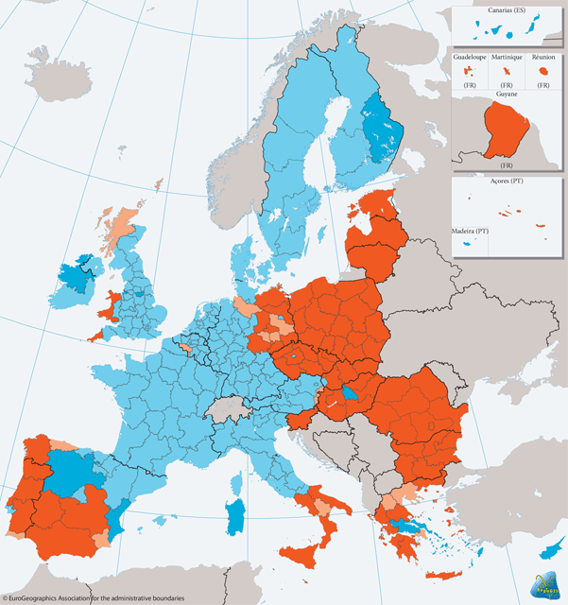


Solidarity in practice: the EU cohesion policy
2007-2013: 347 billion euro invested for infrastructure, business, environment and training of workers for less
well-off regions or citizens
4 Regional fund
4 Social fund
4 Cohesion fund
Convergence objective: regions with GDP per capita under 75% of the EU average. 81.5% of the funds are spent on this objective.
Regional competitiveness and employment objective.
Notes:
This slide will be difficult for most sixth graders to understand, but it can be used in a few ways.
Have students note the area in orange:
Question: Can you figure out what is happening in the orange areas?
Answer: These areas are receiving large amounts of the total EU budget in order to invest in things that will improve their economies.
2) Question: Have you heard American politicians talk about the need to invest/reinvest in America’s future? Which words or areas mentioned in this slide remind you of things talked about in the U.S.?
Answer: Infrastructure/environment/worker training
Onformal assessment: Make sure students know what these terms mean

Slide 21
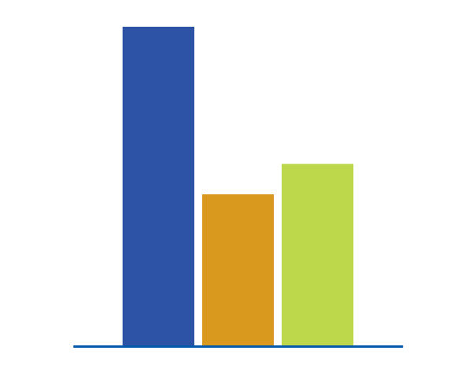
The EU is the biggest provider of development aid in the world
The EU provides 60% of all development aid
93€
53€
44€
EU
Japan
United States
Official development assistance per citizen, 2007
Notes:
Ask students to identify the purposes of this graph.
Emphasize the tremendous investment/reinvestment that the EU is making to improve lives and develop economies.
Point out aid is given to both member and non-member countries (foreign aid).

Slide 22
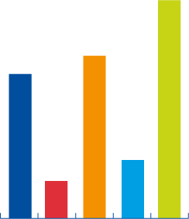

How rich is the EU compared to the rest of the world?
37 300
27 800
24 700
10 793
10 035
10 000
6 400
3676
1 326
468
EU
China
Japan
Russia
United States
EU
China
Japan
Russia
United States
Size of economy: Gross Domestic Product in
billion of euros, 2006
Wealth per person: Gross Domestic Product
per person in Purchasing Power Standard, 2007
Notes:
[Rhetorical question] How can the European Union afford to invest this much? Let’s look at the wealth of the EU.
Ask students if they know the difference between the total size of an economy and per capita comparisons.

Slide 23
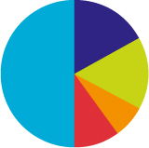
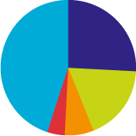
The EU – a major trading power
Share of world trade
in goods (2006)
Share of world trade
in services (2005)
EU
17.1%
EU
26%
Others
50.5%
Others
44.9%
United States
16%
Japan
6.6%
United States
18.4%
China
9.6%
China
3.8%
Japan
6.9%
Notes:
Question: How do the richest countries in the world get wealthy?
Answer: Trade—Explain this has been the case for thousands of years
Question students about the differences between goods and services.

Slide 24
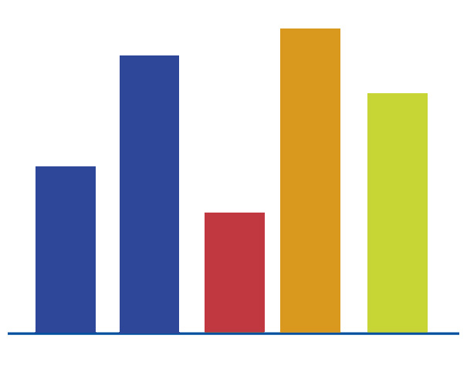
Research - investing in the knowledge society
Spending on research and development in percentage of Gross Domestic Product, 2006
3.3%
3.0%
2.6%
1.8%
1.3%
EU
EU objective
for 2010
China
Japan
United States
Notes:
Question: What future developments are suggested by the information on this graph?
Answer: The EU intends to make a very large increase in its investments in research and developmen
t.
Activity: Students join in small groups where they already sit to discuss the next question
.
Question: Will this have an impact on the United States and/or other countries? How? Why?
Question: How will these things impact YOUR futures and YOUR lives?
Have students report back to the class.
This is the end of the Lesson 3 slide show.

Slide 25
The European Union:
493 million people – 27 countries
Member states of the European Union
Candidate countries
Notes:
This begins the Lesson 5 portion of slide show.

Slide 26

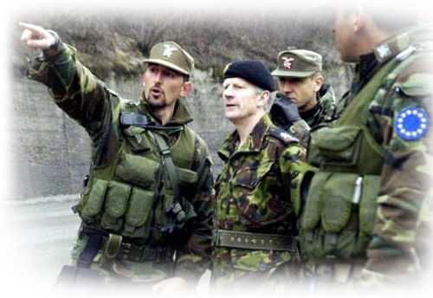
The EU: an exporter of peace and prosperity
4 World trade rules
4 Common foreign and security policy
4 Development assistance and humanitarian aid
EU runs the peacekeeping operations
and the rebuilding of society in
war-torn countries like Bosnia-Herzegovina.
Notes:
We have discovered that the EU has already accomplished much and continues to develop several positive and worthwhile goals—things which can make YOUR world better!

Slide 27

The EU symbols
The European anthem
The European flag
Europe Day, 9 May
The motto: United in diversity
Notes:
Consider these images. What does the future of Europe have in store? Do you think the European Union will ever become something like the United States of Europe? Why or why not?
Divide students into small groups and have them discuss the above questions. Also have them compare the functions of the EU and the US,
Have groups create a Venn diagram showing the EU and the US as the major circle. They should list functions unique to each, and note similarities in the intersecting area.
Report back to the class, creating a large Venn diagram on the board or screen for all to see.

Slide 28
Bibliography
The actual slide contents in this presentation have been downloaded directly from the European Commission’s Europa: The European Union at a glance, and the contents have not been edited in any manner.
Europa: The European Union webpage: http://ec.europa.eu/
Actual slide show web page:http://europa.eu/abc/euslides/index_en.htm
Above web pages accessed August 7, 2009
All Notes content by John Dux, Carmel Middle School Social Studies Dept., Carmel, IN

