Slide 1
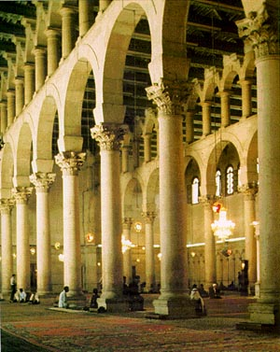
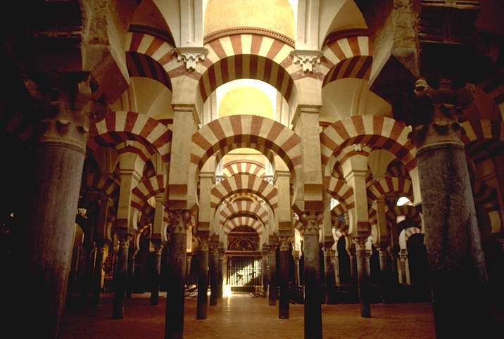
Identifique:
2
1
Notes:
Great Mosque at Damascus
Mosque at Cordoba

Slide 2
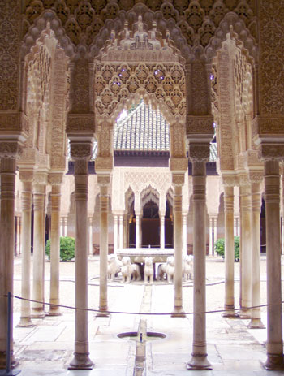
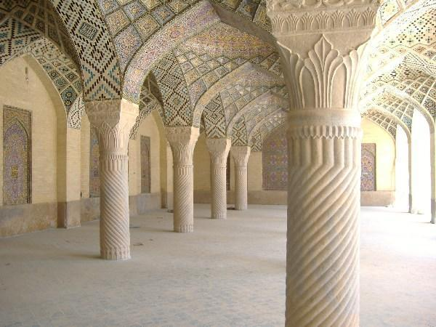
Identifique:
3
4
Notes:
3. Shiraz Mosque
4. Alhambra

Slide 3
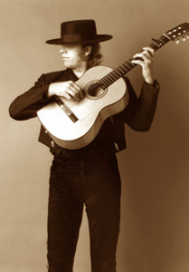
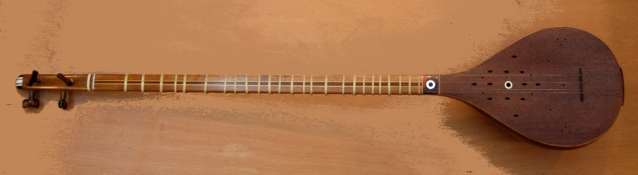
Identifique:
5
6
Notes:
5. Iranian Setar
6. Flamenco Guitarist

Slide 4
Identifique:
If the video does not work, copy & paste this URL into your web browser. http://www.youtube.com/watch?v=OTNx5HQAZ7w
7
8
Notes:
7. Adhan
8. Flamenco Music & Dance

Slide 5

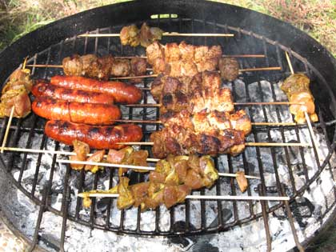
Identifique:
9
10
Notes:
9. Kabobs
10. Pinchos Moros

Slide 6
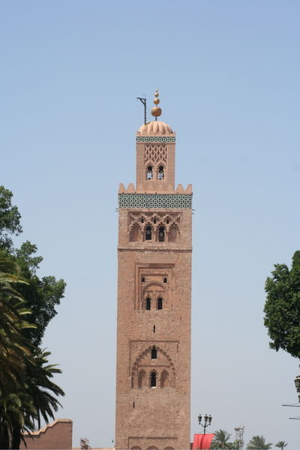
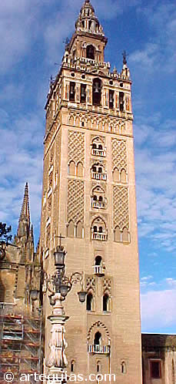
Identifique:
11
12
Notes:
11. Koutoubia Minaret at Marrakesh
12. Giralda Minaret at Seville

Slide 7
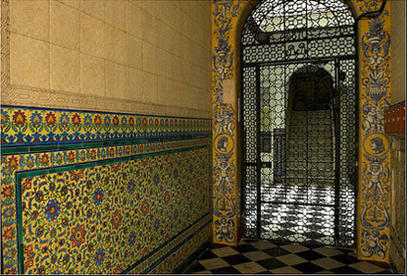
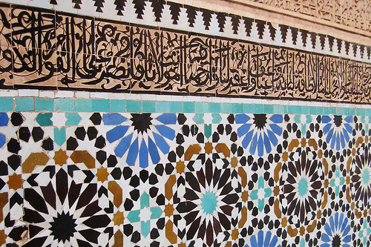
Identifique:
14
13
Notes:
13. Mosaic at Marrakesh
14. Mosaic entry at Seville

Slide 8
Sources
http://instruct1.cit.cornell.edu/courses/nes257/damascus.html
http://www.essential-architecture.com/STYLE/STY-Moorish.htm
http://www.travelblog.org/Photos/105521.html
http://photos.igougo.com/pictures-photos-l791-p107204-Alhambra.html
http://en.wikipedia.org/wiki/Image:Setar.jpg
http://www.freewebs.com/electricgypsy/maker.htm
http://www.youtube.com/watch?v=OTNx5HQAZ7w
Islam-a short introduction, Dr. Mohamed Esa, McDaniel College
http://www.alhamratx.com/1694031.html
http://www.notesfromspain.com/2006/09/22/cuisine-from-spain-podcast-14-pincho-moruno-kebabs/
http://www.travelblog.org/Photos/1456678.html
http://www.arteguias.com/torre/giraldasevilla.htm
http://doorwaysaroundtheworld.wordpress.com/2006/10/
http://flickr.com/photos/given_to_fly/334673599/

