Slide 1
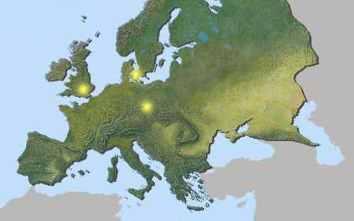
Understanding Europe-
A Cultural Mosaic
By Lila Doma and Liz Grau
Indiana University West European Studies Office

Slide 2
Northern Europe

Slide 3
Northern Europe- Rest Stop
How do you get around your city? In many European metropolitan areas, citizens do not own cars. Therefore, they must rely on walking or public transportation. The London Underground is one of the oldest subway systems in the world and makes 3 million passenger journeys daily. Can you guess what the following message means?

Slide 4
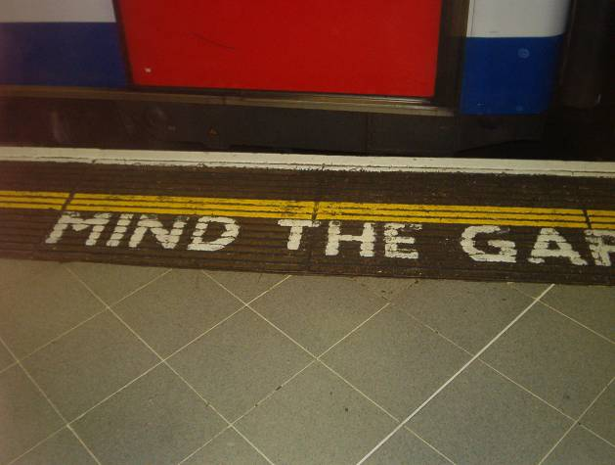
London Underground

Slide 5
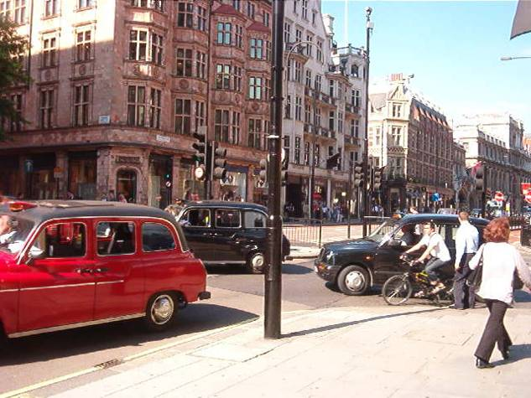
London street

Slide 6
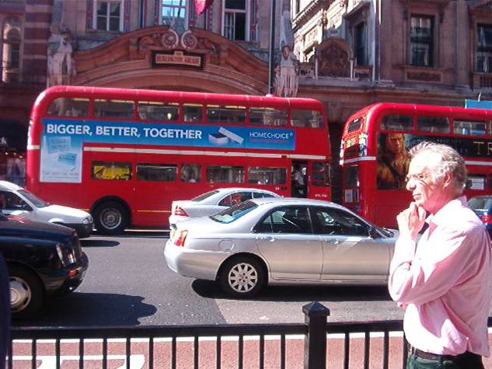
London’s Famous Double-decker Busses

Slide 7
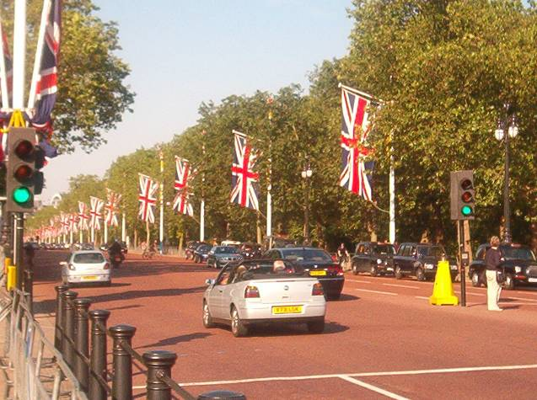
The Strand

Slide 8
Northern Europe- Rest Stop
Traditional tea time in London is from the hours of 2-4pm. People from all over the city gather at Fortnum and Mason for tea and scones with butter and strawberry jam. There are many options for teas and food…iced tea, fruit plates with cheese, pastries are all a part of the tea time menu. Afternoon tea is seen as a time to get together with friends and chat about day to day matters. It is also a great time to reflect alone on life issues. Taking time for yourself, your friends, and your family is something that is valued greatly in Europe.

Slide 9
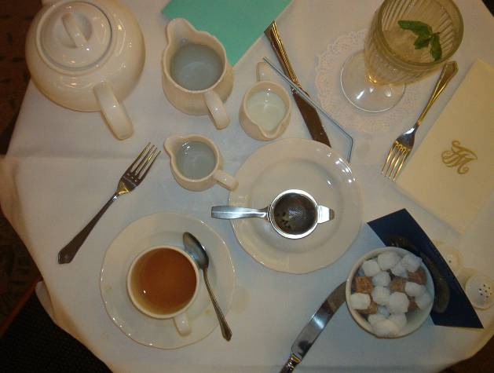
High Tea Table Setting

Slide 10
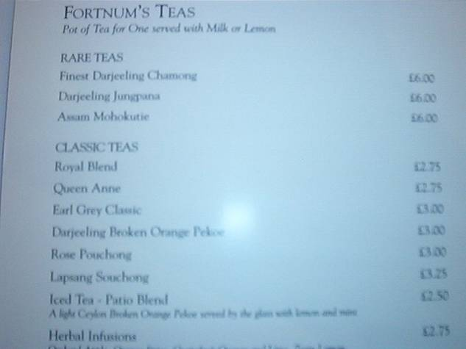
Tea Menu

Slide 11
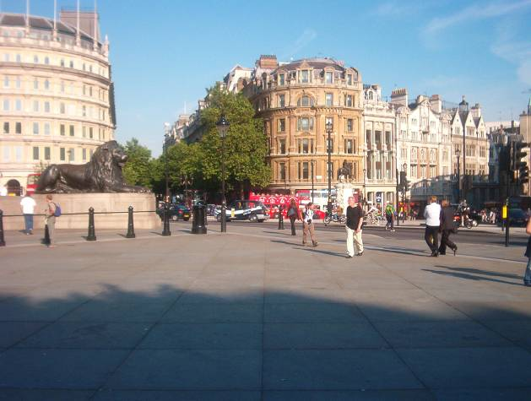
Trafalgar Square

Slide 12
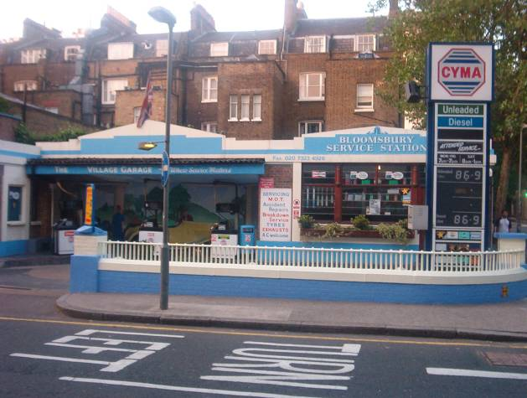
Q: What do you think this is?

Slide 13
Answer:
A Service Station

Slide 14
Northern Europe- Rest Stop
Buckingham Palace has been the home to the royal family of England since 1837. It also serves as the administrative headquarters for the monarchy. The people that work here ensure that the queen’s day to day activities run smoothly. Also in attendance at Buckingham Palace are the many tourists, and guests that are invited for ceremonies, etc. During the summer, the Changing of the Guard ceremony occurs every day at 11:30am. The palace is over 300 years old.

Slide 15
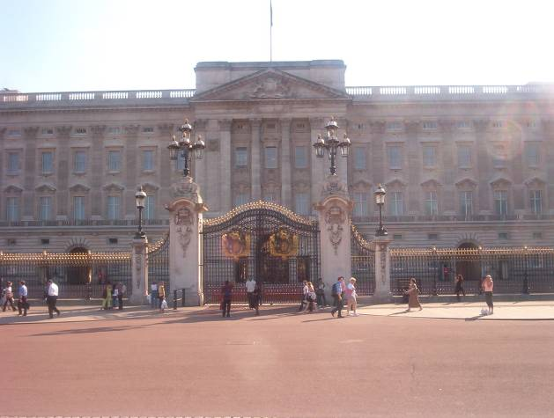
Buckingham Palace

Slide 16
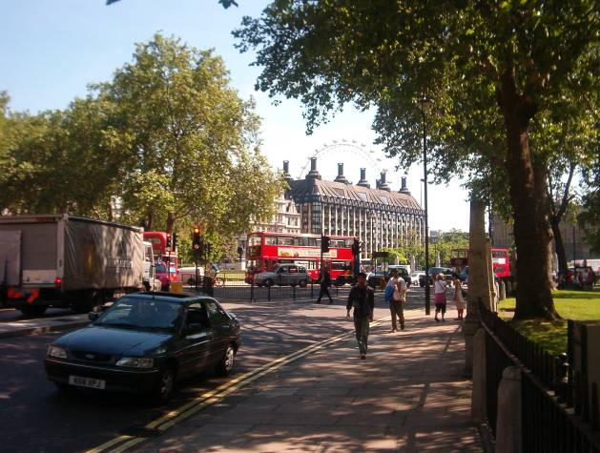
London street scene

Slide 17
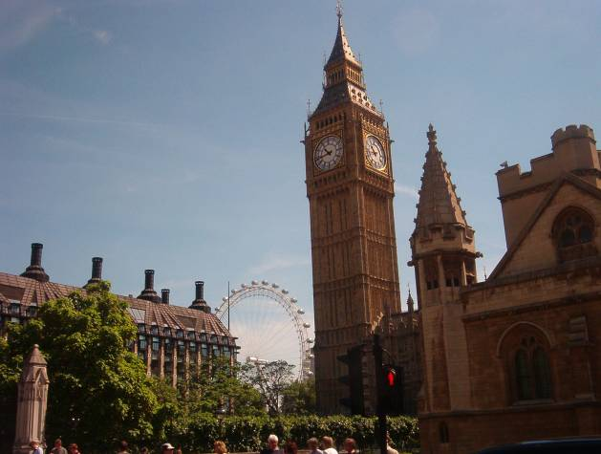
Big Ben and the London Eye

Slide 18
Northern Europe- Rest Stop
Hyde Park is one of several Royal Parks in London. Henry VIII acquired the large chunk of land in 1536, and it was originally used for hunting. Now it is a beautiful stretch of land where people can go have a picnic, or just relax. Hyde park is the home to Lake Serpentine, and also Speakers’ Corner, where people are able to voice their opinions about public matters. It is a very historical spot.

Slide 19
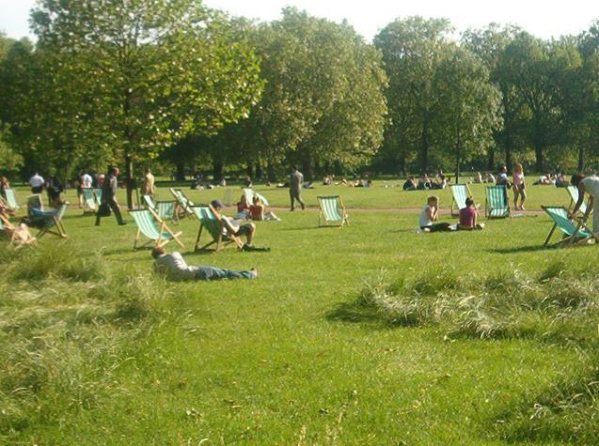
Hyde Park

Slide 20
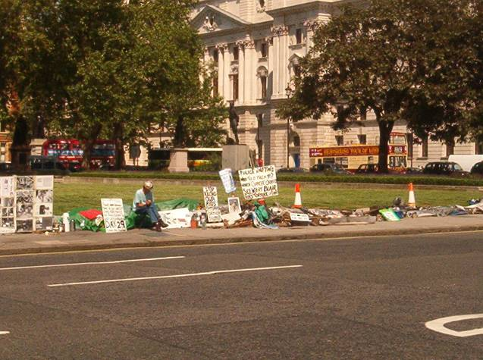
Speaking of Opinions…. A Scene Outside Parliament

Slide 21
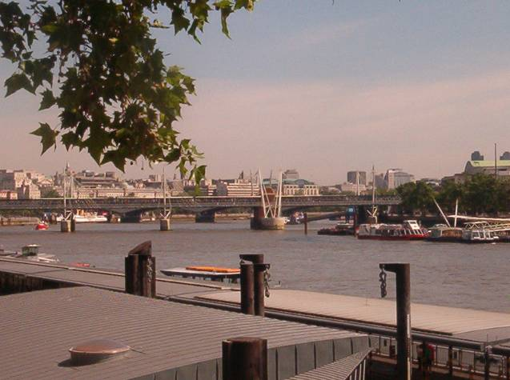
Thames River/ Millennium Bridge

Slide 22
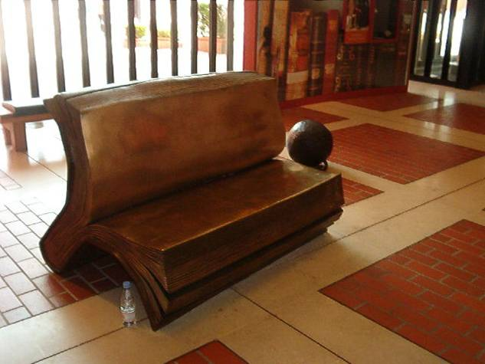
What is the message of this bench?

Slide 23
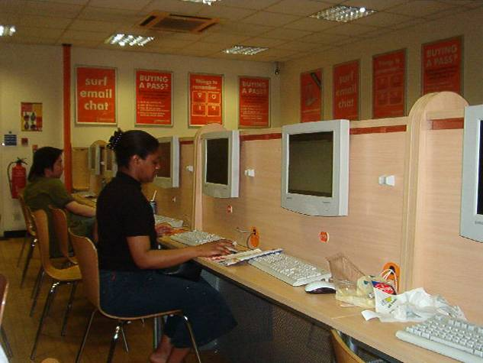
An Internet Cafe

Slide 24
Northern Europe- Rest Stop
Soccer (a.k.a. Football) is the source of much entertainment and athleticism in Europe. The EURO soccer tournament brings teams from all over Europe. In the 31 played games, large crowds gather to cheer on their favorite teams. The popularity of soccer in Europe can easily be compared to football in the United States. Some games can draw up to 93 million viewers…topping even the most prestigious football game in the States, the Super Bowl. Soccer players are viewed as celebrities in Europe, and are often given benefits from as high up as the royalty.

Slide 25
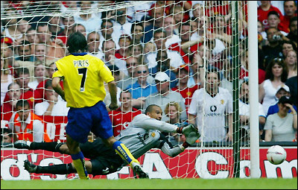
Soccer…. Or….. Football

