Slide 1
History of Conflict An introduction to the situation in Northern Ireland _____________________________________
Created by Keith O’Connell
Penn High School
2004

Slide 2
Background Data
The conflict in Northern Ireland is between two groups; Protestants and Catholics. The conflict is not necessarily about religion, but it does have some significance in the history of the conflict.
The current population of Northern Ireland is 1.5 million. 55% of the population is Protestant, 45% Catholic.
Today, the two groups place their emphasis on different elements of the problem.

Slide 3

Protestant Beliefs
Have a constitutional right to the land
Preserving the Union with Britain
Resisting the perceived threat of a United Ireland

Slide 4
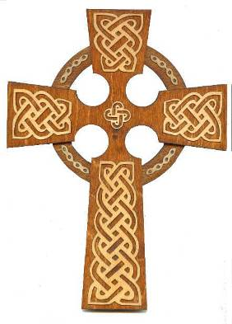
Catholic Beliefs
For some, Northern Ireland remains a National struggle
Self determination
Others viewed the conflict as a struggle against unfair practices by the Unionist government between 1920-1970

Slide 5
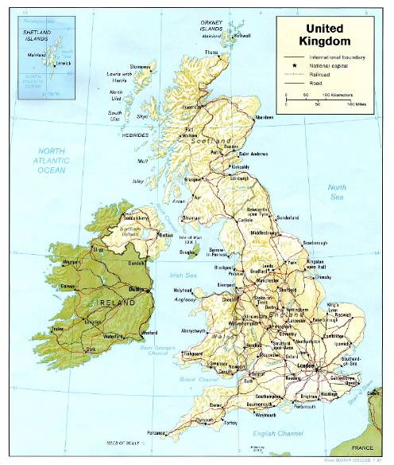
Historical Background
The proximity of Britain and Ireland has lead to a long history of interaction and linkage.

Slide 6
Key Dates in Northern Ireland History
1170- Settlers from Britain arrive in Ireland
1608 -Plantation of Ulster began English and Scottish settlers moved into the north
1641- The Catholic-Gaelic rising in response to the Plantation and the confiscation of land by Protestant settlers from England and Scotland
1690- The Battle of the Boyne and the victory of Protestant William III over Catholic James II - this victory is still celebrated in many parades in Northern Ireland
1801- Act of Union which abolished the Irish Parliament and bound Ireland and Britain together as parts of the United Kingdom
1912 -Ulster Solemn League and Covenant signed by over 400,000 Protestants who wanted to remain in the Union
1916- The Easter Rising in Dublin against British rule

Slide 7
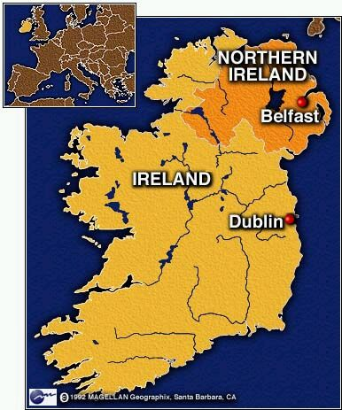
Creation of Irish Free State / Northern Ireland
In 1921, the island of Ireland was partitioned by the British government. The 26 southern counties gaining independence from Britain, while the 6 northeastern countries remained part of the United Kingdom

Slide 8
Northern Ireland
At the time, the 6 northeastern counties had a built-in Protestant majority (65/35)
Ethnic bias in the distribution of housing and welfare services lead to more turmoil between the two sides

Slide 9
Beginnings of “The Troubles” ___________________________
Started in the 1960’s -Civil Rights Campaign
Catholics-inspired by the worldwide civil rights movement
Protestants – saw this as a threat to Northern Ireland’s existence –responded hostile to demonstrations

Slide 10
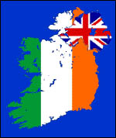
“The Troubles”
1969 – London deployed the British Army to restore order.
To most Catholics, they were seen as protector of the Northern Ireland state and repressive majority population. (others – British troops on Irish soil)

Slide 11

Creation of Paramilitary Groups
The creation of the Provisional Irish Republic Army (PIRA –later shortened to IRA) was organized in response to British engagement into the civil rights movement. The IRA gained members during the 1970’s and became more violent in their tactics.

Slide 12
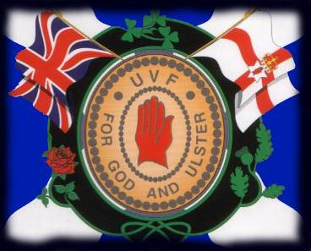
Creation of Paramilitary Groups
Ulster Volunteer Force (UVF)
-Loyalist Paramilitary Group. Formed primarily in response to IRA, also used violence to help its cause.

Slide 13
Formation of the Peace Process
As the two sides fought against each other for most of the 1970’s and early 1980’s, it became evident that progress was never going to be made using force. Instead, the IRA and UVF began aligning with political parties in Northern Ireland as a way to fight for their goals.

Slide 14

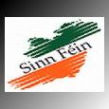
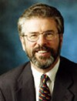
Sinn Fein- Republic Ireland
Sinn Fein – The political wing of Republicanism and the IRA.
Leader-Gerry Adams

Slide 15
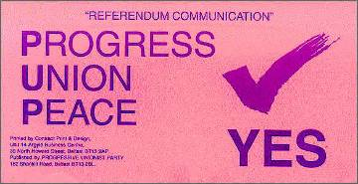

Progressive Unionist Party and Democratic Unionist Party
Progressive Unionist-
Was involved in
discussions leading to
negotiations between
the parties.
Democratic Unionist- Continues
to remain loyal to Britain

Slide 16
Continuing towards Peace- “Frameworks for the future”
Starting in the early 1990’s, steps were being taken by both sides to show their willingness to live in peace.
The ceasefire of 1994 by the IRA was seen as a positive sign that would eventually bring both sides to diplomatic relations for the first time in several decades.

Slide 17
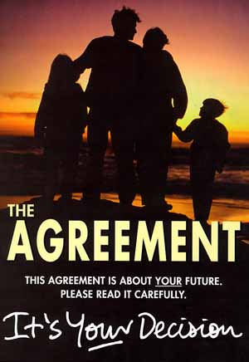
Good Friday Agreement April 1998
The agreement reached 5 main points:
Future constitutional status was in the hands of its citizens
If the people wanted to unite, they could by voting
Current constitutional position remains within the UK
Citizens could be Irish, British, and both
Republic of Ireland would drop territorial claim

Slide 18
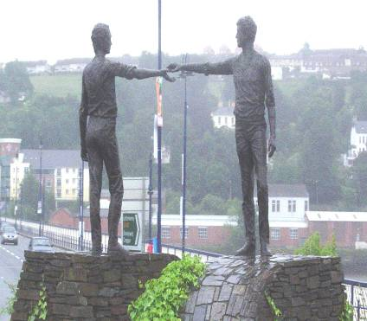
Future of Northern Ireland?
With continued peaceful agreements, the hopes of those in Northern Ireland is to move forward and begin a new chapter in what was been a struggle to co-exist for the past several decades and begin the healing process.

Slide 19
Works Cited
Conflict Archive on the Internet (CAIN)
http://cain.ulst.ac.uk/index.html
Sinn Fein
http://sinnfein.org/
Ulster Volunteer Force
http://www.fas.org/irp/world/para/uvf.htm

Slide 20
Special Thanks!
Special thanks to the West European Studies National Resource Center for the opportunity to research this topic in depth.

