Slide 1
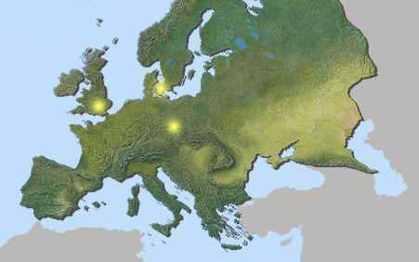
Understanding Europe- A Cultural Mosaic
By Lila Doma and Liz Grau
Indiana University West European Studies Office

Slide 2
Southern Europe

Slide 3
Southern Europe- Rest Stop
Can you imagine a world without paved roads? Even more strange, what about a city built on water? In Venice, Italy, a system of canals creates transportation for the water-logged citizens. Venetians travel from one part of the a-MAZE-ing city by either foot or boat. Water taxis, water buses… Guess the purpose of the vehicle in this next picture.

Slide 4
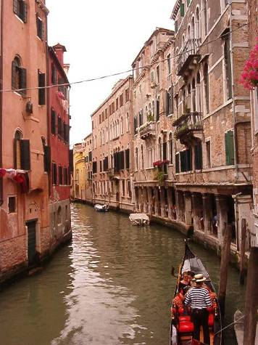
Traveling By Gondola

Slide 5
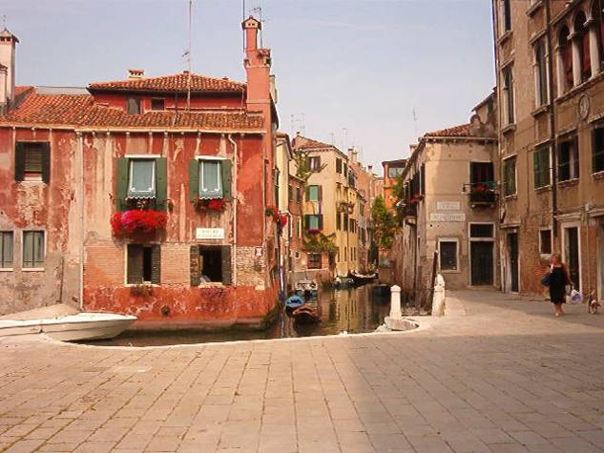
The Streets of Venice

Slide 6
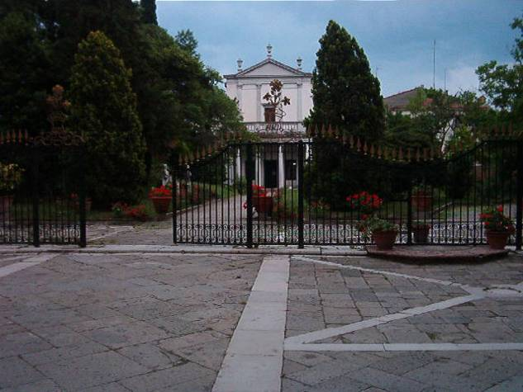
A Garden in Venice

Slide 7
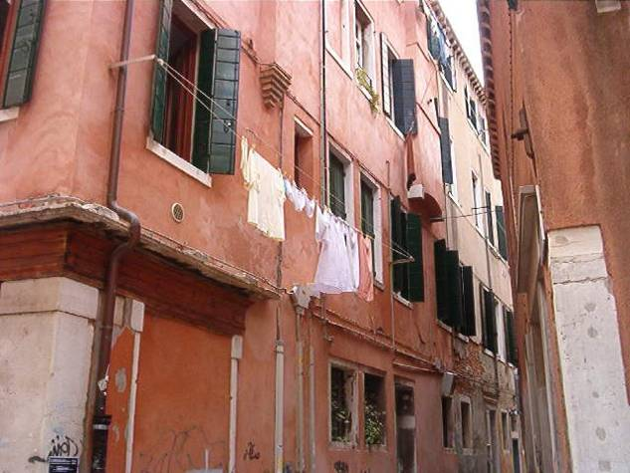
Doing Laundry in Venice

Slide 8
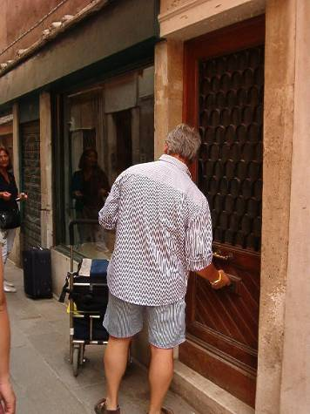
Delivering Mail in Venice

Slide 9
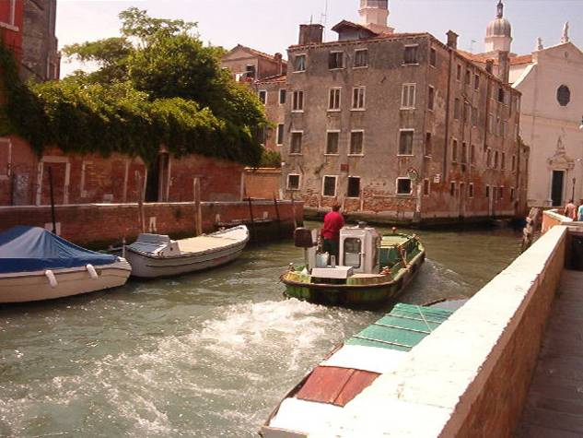
Taking out the Trash!

Slide 10
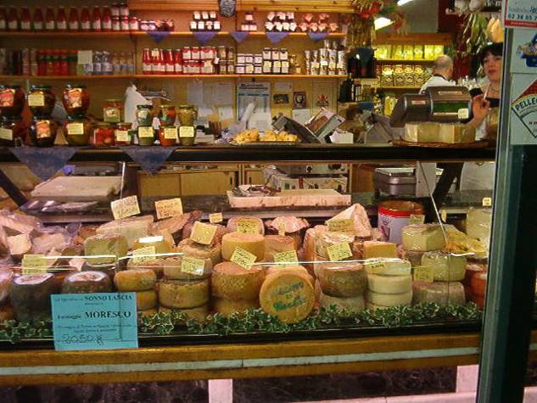
A Cheese Market in Italy

Slide 11
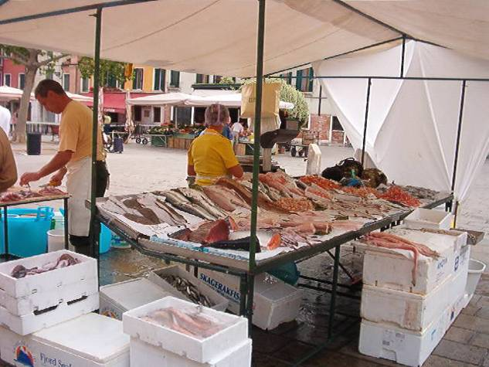
A Fish Market in Venice

Slide 12
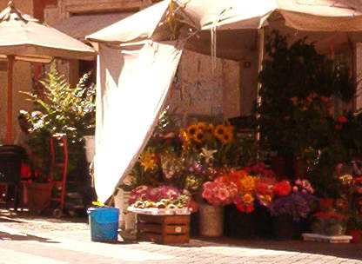
A Flower Shop in Venice

Slide 13
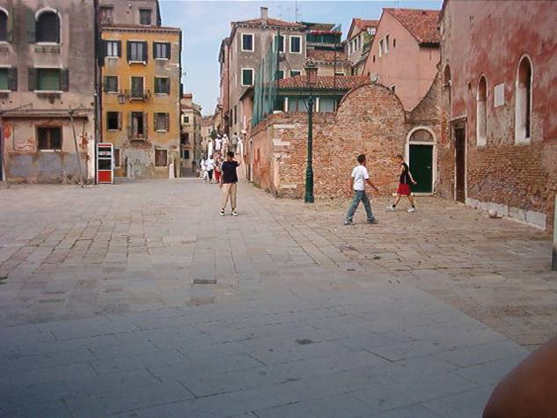
Soccer Players in Venice

Slide 14
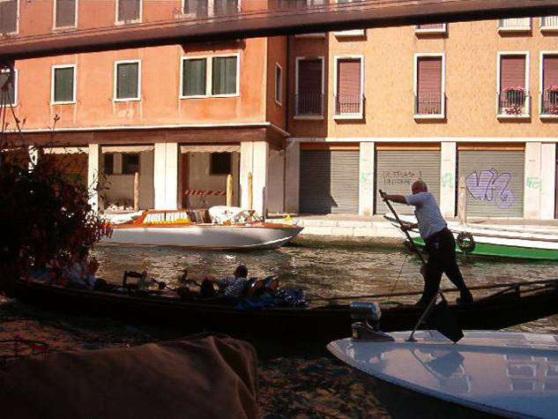
Graffiti In Venice?

Slide 15
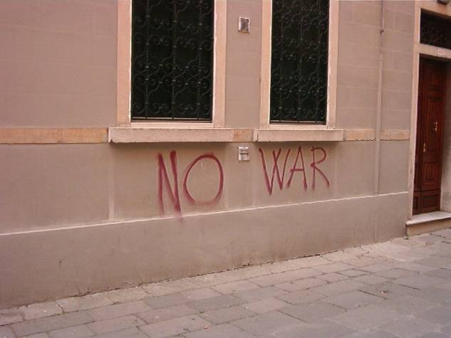
Graffiti In Venice?

Slide 16
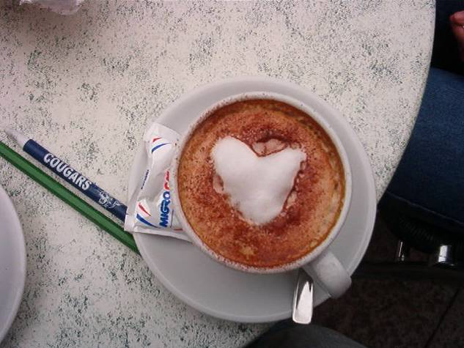
The City of LOVE

Slide 17
Southern Europe- Rest Stop
Venetian glass is one of the major artifacts that can be found in Venice. The island of Murano is known for its superb glass blown pieces. When visiting Murano, it is easy to catch glass-blowing shows. Glass is stored at 1800 degrees F. It is taken in big chunks and shaped by using tools to stretch and mold the glass. After the shape is formed, the glass is cooled in a 24-hour process. It is first stored at temperatures around 1000 degrees F and then throughout the cycle eventually reduced to room temperature. Let’s just say the room got pretty hot!

Slide 18
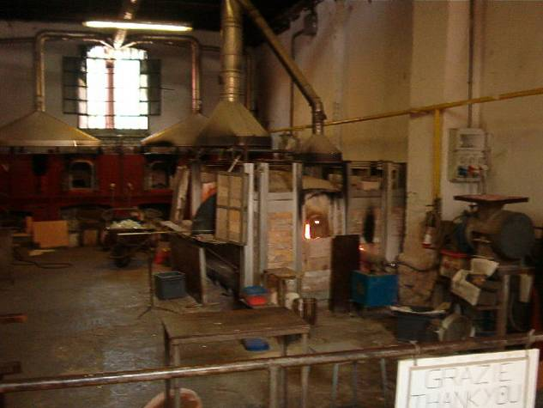
Glass Blowing in Murano

Slide 19
Southern Europe- Rest Stop
The Renaissance was a rebirth that occurred throughout most of Europe. However, the changes that we associate with the Renaissance first occurred in the Italian city of Florence. The city's economy and its writers, painters, architects, and philosophers all made Florence a model of Renaissance culture. Look at the following pictures. What remains of the Renaissance in Florence today?

Slide 20
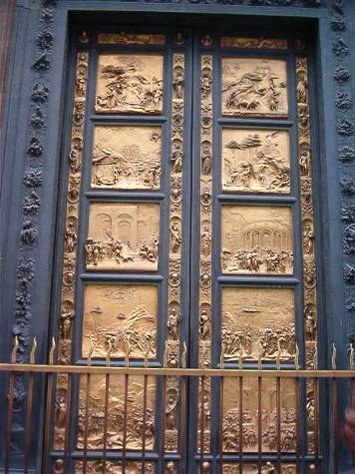
Brunalleschi’s Golden Doors

Slide 21
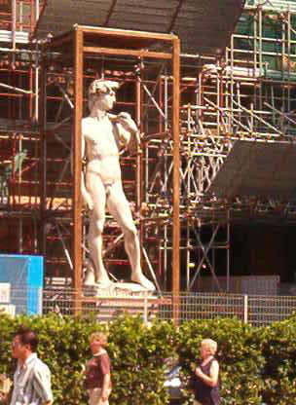
David

Slide 22
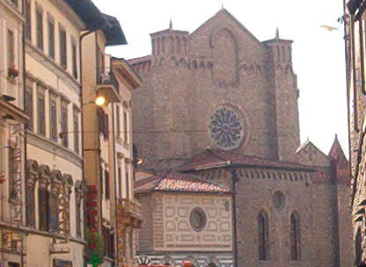
St. Maria Novella

Slide 23
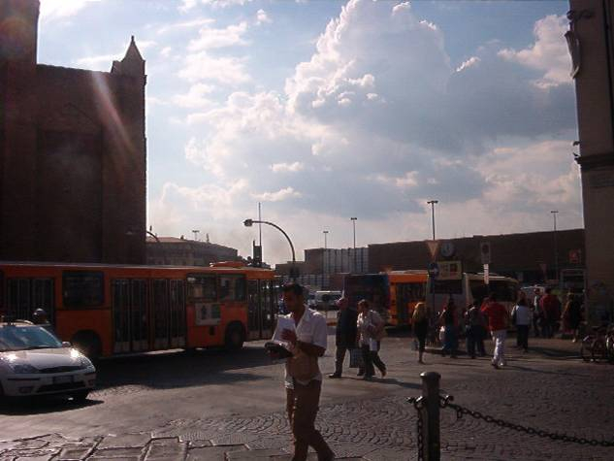
Old and New in Florence

Slide 24
Southern Europe- Rest Stop
For six decades, Florentine architects worked on the Cathedral…or the Duomo. Atop of the Duomo is the Cupola that overlooks the entire city of Florence. Brunalleschi and Giotto are two of the masterminds behind this venture. While climbing the 460 something steps to the top of the Cupola, a tourist can stop at two different levels on the inside of the Cathedral. The first level provides a spectacular view of the church below. The second level brings you so close to the frescoes at the top of the Cathedral; you can see all the fine details. After viewing the two levels, you climb a little further until you are outside and able to see the most magnificent view of the city. A climb that is definitely worth taking.

Slide 25
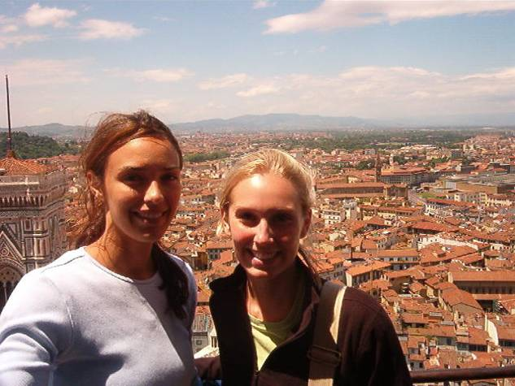
Doma and Grau

Slide 26
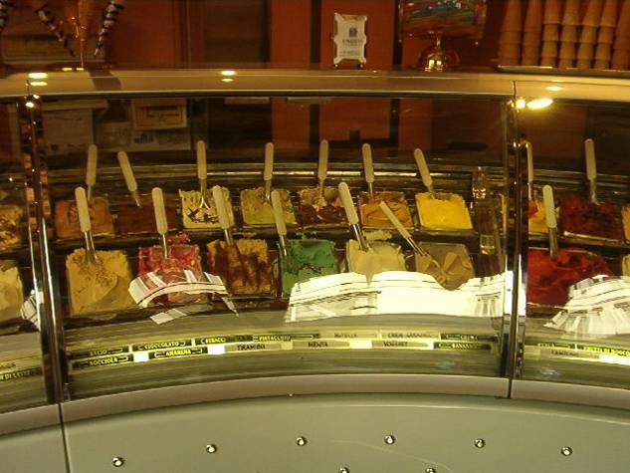
The Famous Gelato

Slide 27
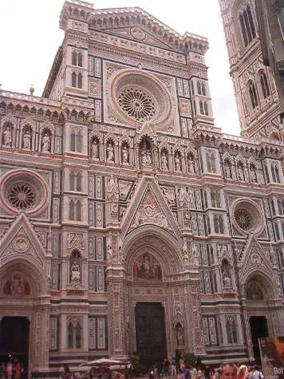
The Duomo

Slide 28
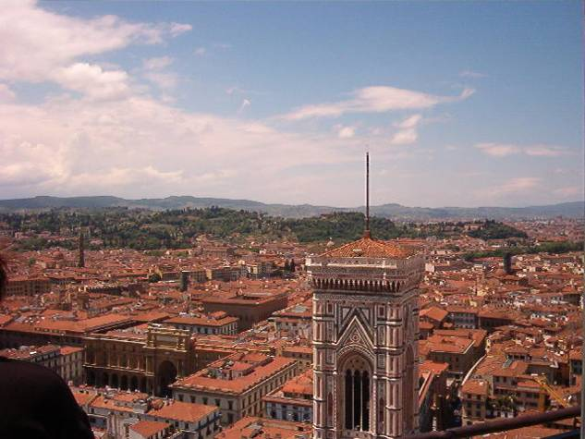
View from atop

Slide 29
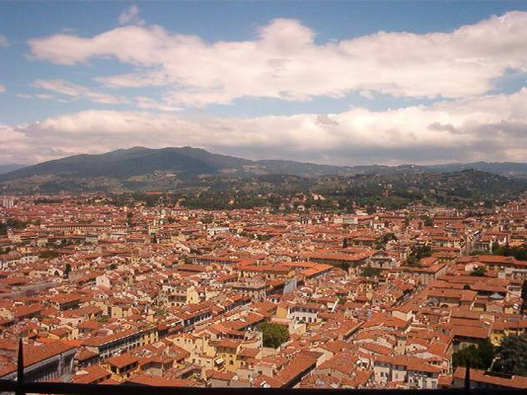
Breathtaking!

Slide 30
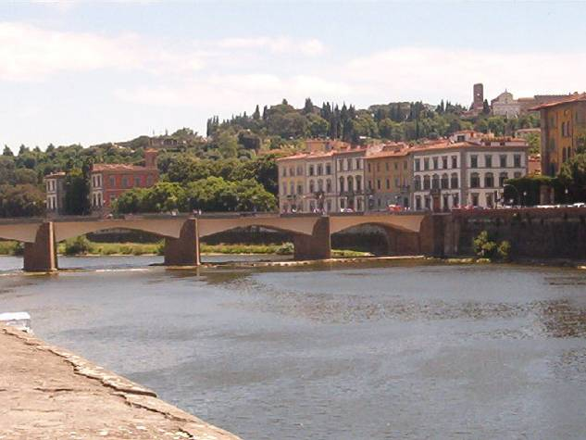
The Arno River of Florence!

Slide 31
Southern Europe- Rest Stop
The palace of the Uffizi was at one time one of the most extravagant interior in Florence. At the times of Cosimo and the Medici clan, this building was erected to house 13 judges from Florence who directed the city affairs. Frescoes designed by Botticelli line the walls of this building. 28 sculptures of famous Florentines also are housed here. This palace is a symbol of the importance of the Medici family and their love for art during this time period.

Slide 32
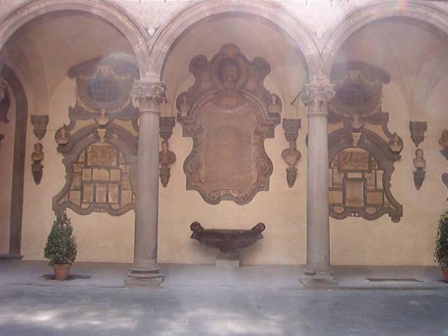
The Uffizi Palace

Slide 33
Southern Europe- Rest Stop
Perhaps one of the most amazing day trips to take in Italy is a visit to the Ancient Roman Ruins. These magnificent structures include the Coliseum, the Arch of Constantine, the Pantheon, the Forum, and Palatine Hill…to name a few! The Coliseum was constructed during the years 72-80 A.D. It is an elliptical stadium, and at one time could house over 50,000 spectators. It was here that the gladiators would fight each other, or hunt exotic animals from all over the world. In many pictures the Coliseum looks as though it has deteriorated. This is not true. In fact, about 2/3 of the Coliseum was used to help rebuild churches and other buildings throughout Rome.

Slide 34
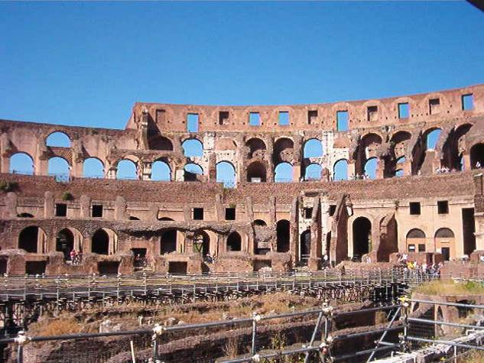
The Coliseum

Slide 35
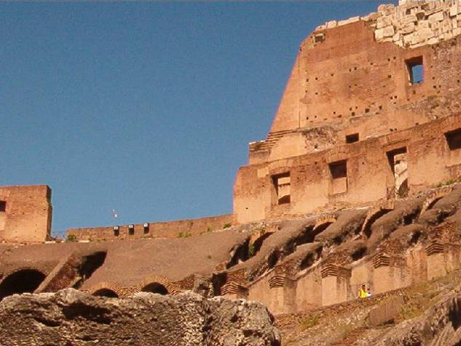
The Coliseum

Slide 36
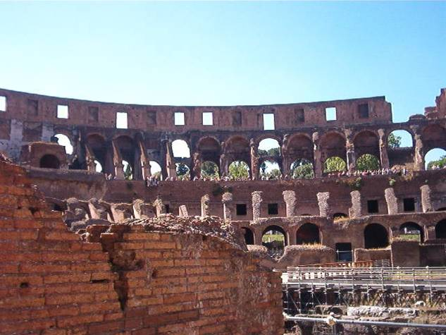
The Coliseum

Slide 37
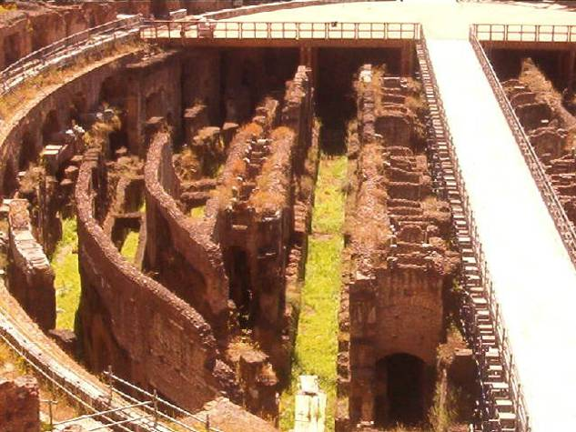
The Coliseum

Slide 38
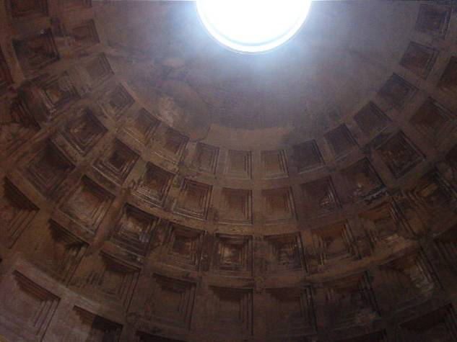
The Pantheon

Slide 39
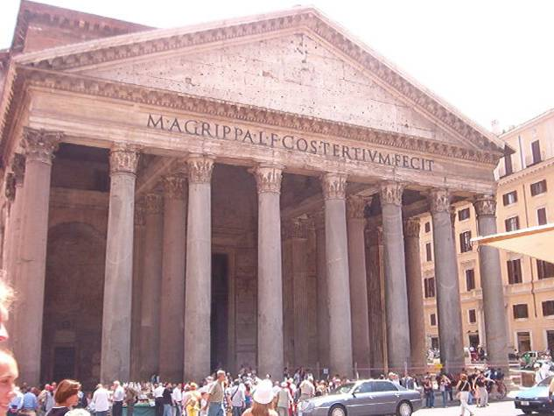
The Pantheon

Slide 40
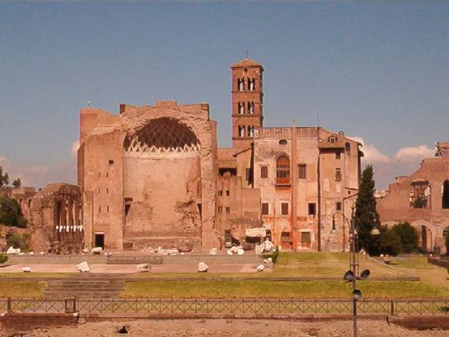
Roman Theater

Slide 41
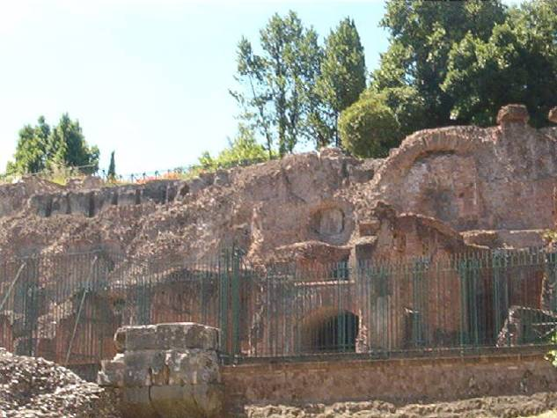
Roman Ruins

Slide 42
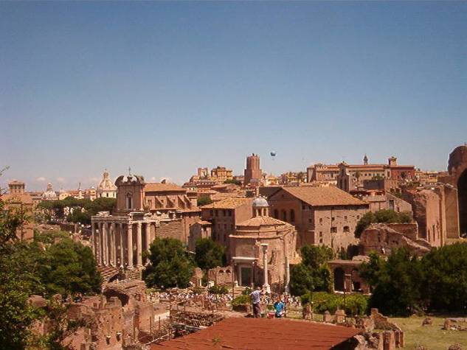
The Ruins from a hilltop

Slide 43
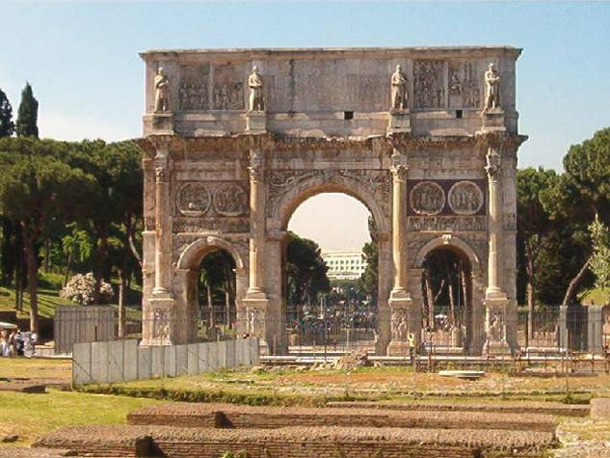
The Arch of Constantine

Slide 44
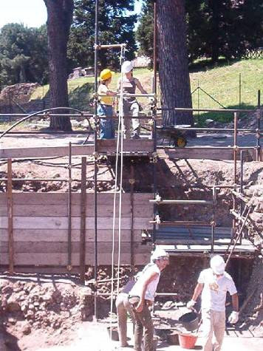
Construction in Rome

Slide 45
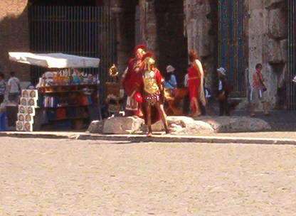
Gladiator Performing

Slide 46
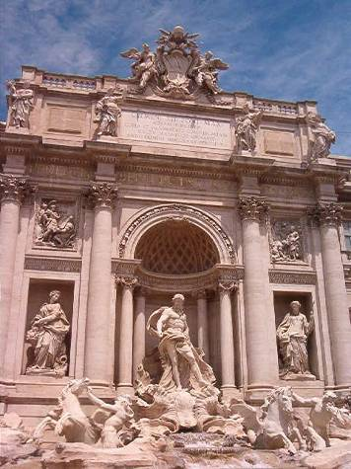
Trevi Fountain

Slide 47
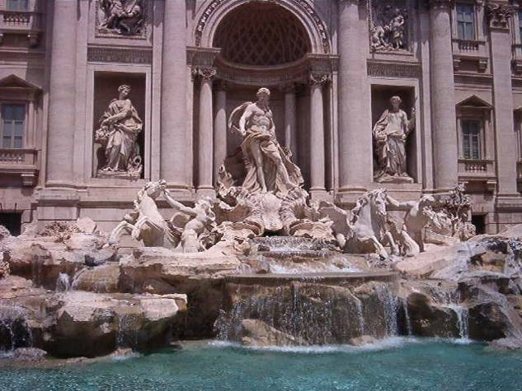
Trevi Fountain

Slide 48
Southern Europe- Rest Stop
The Sistine chapel is known to be one of the greatest works of art. Michelangelo was commissioned by the Pope to paint the ceiling of the chapel. This is where Michelangelo set out to do the impossible: paint an entire ceiling upside down. The ceiling is a lot larger than I had thought it would be. The ceiling took about 4 years to create.

Slide 49
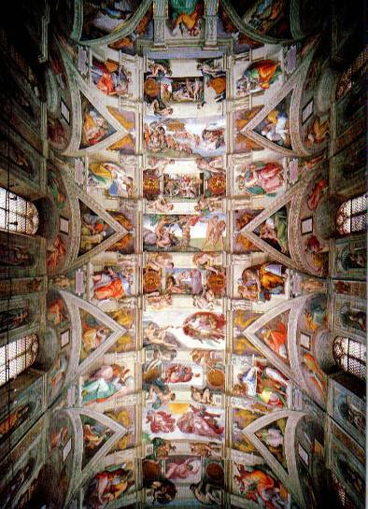
Sistine Chapel Ceiling

Slide 50
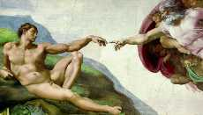
The Creation

Slide 51
Southern Europe- Rest Stop
Vatican City is an amazing landmark of the Catholic Church, once the mightiest power in Europe. The territory, located on the outskirts of Rome, Italy is actually its own country, with a theocratic government headed by the pope. Perhaps the most breathtaking site to see in Vatican City is the world-famous St. Peter’s Basilica with a brick dome that rises 390 feet above the floor and stunning masterpieces by Raphael and Michelangelo.

Slide 52
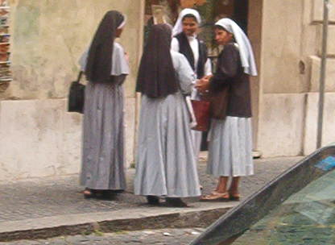
Nuns in Vatican City

Slide 53
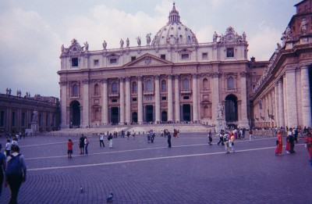
St. Peter’s Basilica

Slide 54
Southern Europe- Rest Stop
What does a city have to do to get ready for the Olympic games? In Athens, most of the city was under construction to prepare for the mass amount of people visiting for the 2004 summer games. In order to put its best foot forward, even the ancient buildings at Acropolis were getting a facelift!

Slide 55
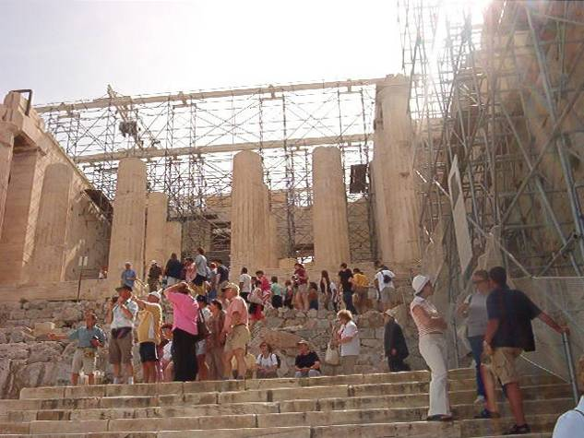
Construction on the Acropolis

Slide 56
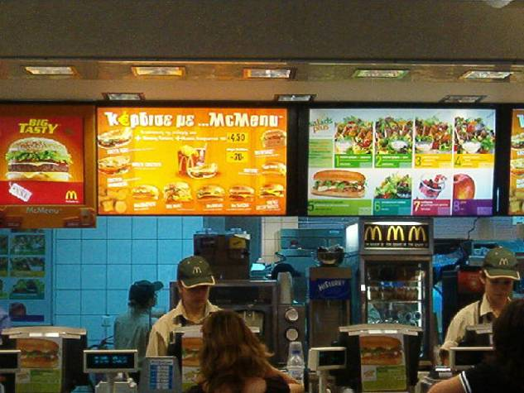
Mc Pita in preparation for Olympics

Slide 57
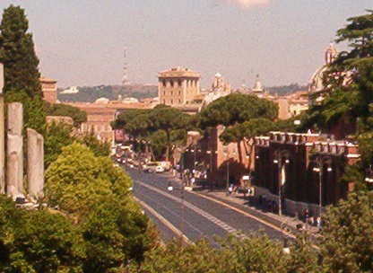
Getting Ready

Slide 58
Southern Europe- Rest Stop
The Acropolis hill, also known as the "Sacred Rock" of Athens, is the most historical site of Athens. Many of Ancient Greece’s most important buildings still stand proud on the hill and date back to 450-330 B.C. The monuments on the Acropolis reflect the many phases of the city's history

Slide 59
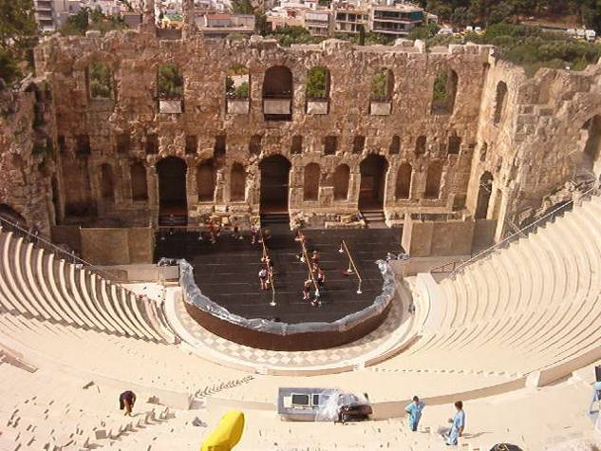
The Acropolis Theater

Slide 60
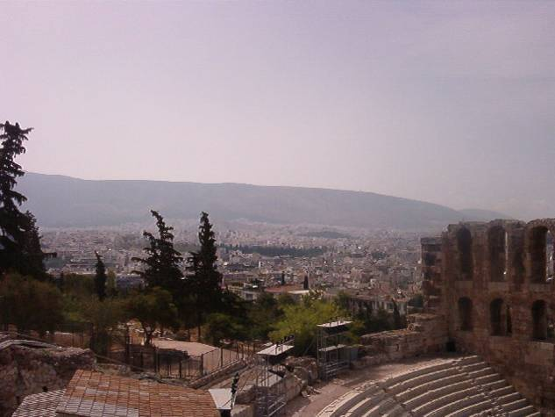
The View from the Acropolis

Slide 61
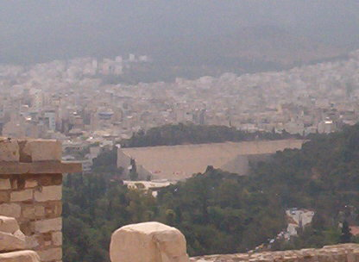
The View from the Acropolis

Slide 62

Women Statues on Temples

Slide 63
Western Europe

Slide 64
Western Europe- Rest Stop
One beauty that Austria is known for is it’s spectacular rose gardens. There are over 800 types of roses in these gardens. The months to visit these gardens are May through July. There are many events that occur in the rose gardens including weddings, family gatherings, and other celebrations.

Slide 65
Western Europe- Rest Stop
Vienna has been known for its musical influence across the world, and throughout history. It has been home to Mozart, Beethoven, Schubert, and Strauss. These amazing composers have influenced many musical greats. Today, Vienna houses the Philharmonic orchestra, along with many other musical events.

Slide 66
Western Europe- Rest Stop
The Eiffel Tower is noted as the most recognized European monument worldwide. The tower was built in remembrance for the French Revolution and greeted visitors to the 1889 World’s Fair in Paris. What are some other famous monuments? What is their significance? What does that say about the countries that built them?

Slide 67
Western Europe- Rest Stop
When England and France decided to connect their two countries with a 32-mile rail tunnel beneath the English Channel, engineers were faced with a huge challenge. Not only would they have to build one of the longest tunnels in the world; they would have to ensure publics safety in a tunnel this size. $21 billion dollars later, the Chunnel has connected over 40 million passengers from France to England and remains to be one of the greatest engineering feats of modern time.

Slide 68
Western Europe- Rest Stop
Many artists, writers, and other forward-thinkers were lured to Paris in search of academic and artistic freedom during and after World War II. Under the influence of breath-taking views and potent espresso, they managed to create the dramatic tone for the artistic community that dominates Paris today. Can you see why Paris has been such an inspiring city for centuries?

