Slide 1

Switzerland:
The Heart of it All

Slide 2
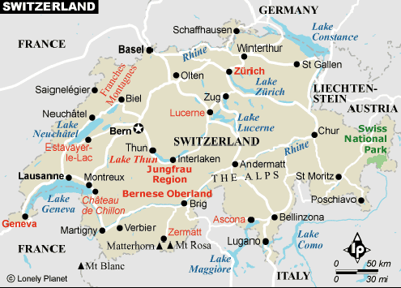
Switzerland: The Heart of the Alps

Slide 3
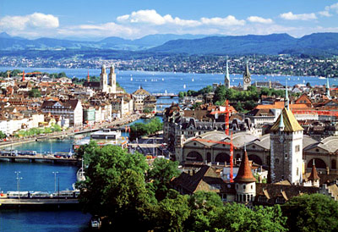
Zurich

Slide 4
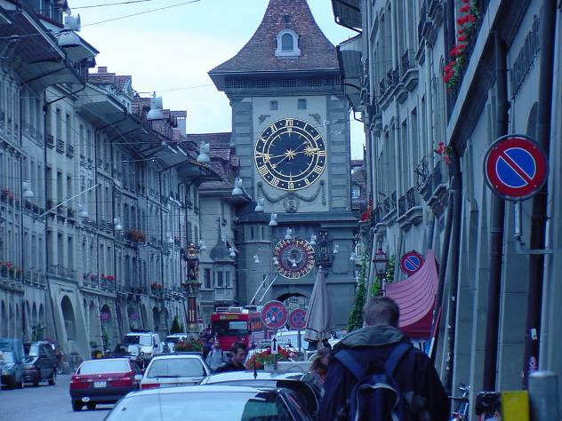
Berne, the capital of Switzerland

Slide 5
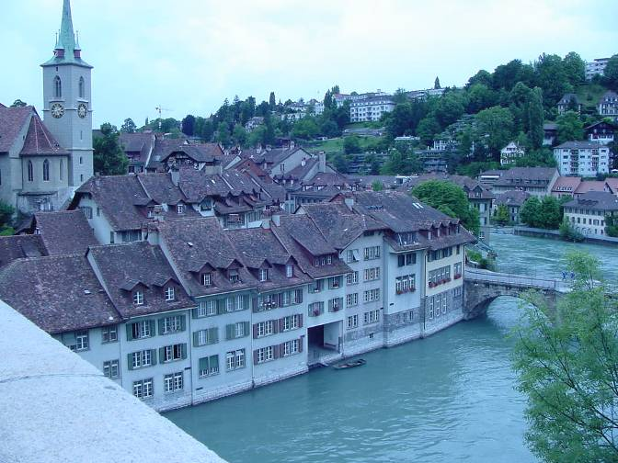
The medieval part of the city on the river Aare

Slide 6
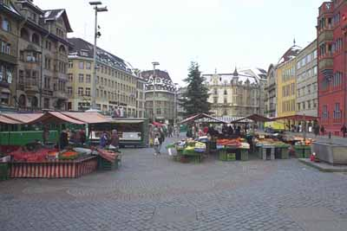
Marketplatz
Basel, Switzerland

Slide 7
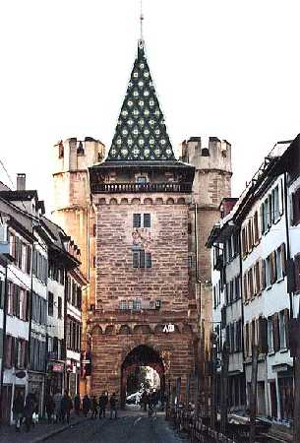
Spalentor Gate: Entrance to the Altstadt (old city) in Basel

Slide 8
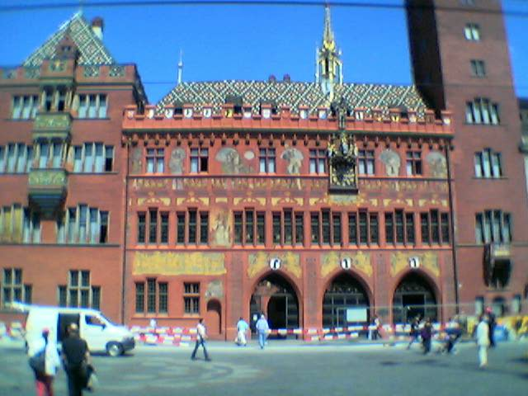
Rathaus (government building)

Slide 9
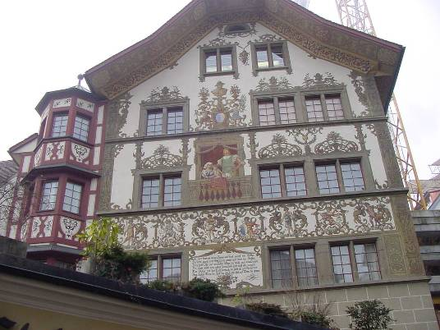
Lucerne, Switzerland

Slide 10
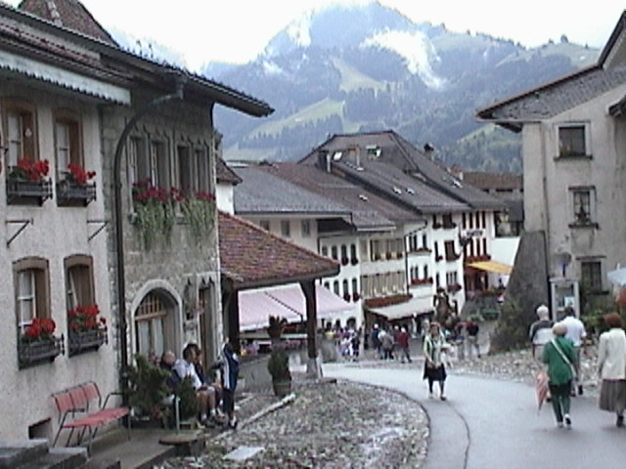
Gruyere, Switzerland

Slide 11
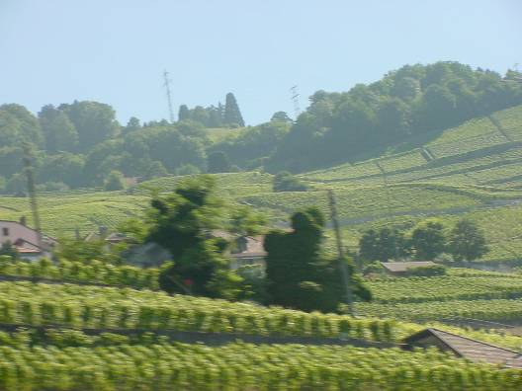
Vineyards in Montreux, Switzerland

Slide 12
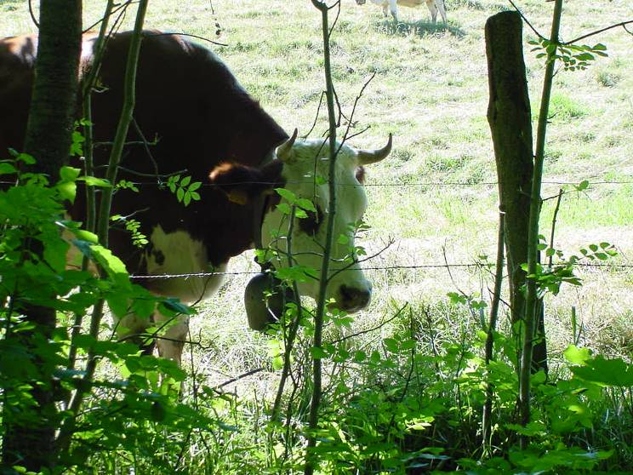
Regoldswil, Switzerland

Slide 13
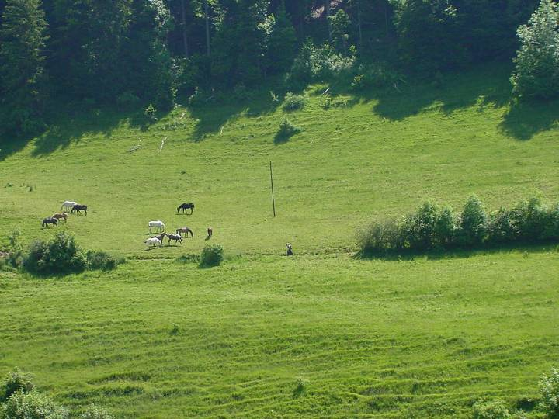
Farming in the Swiss countryside

Slide 14
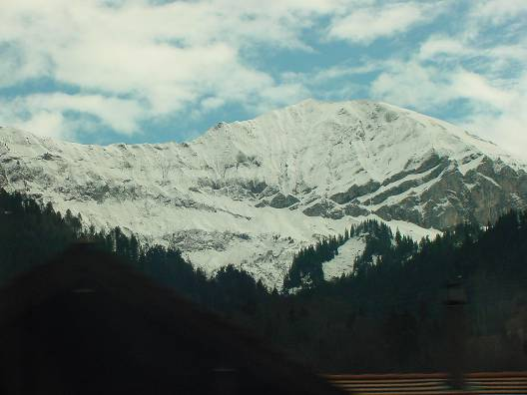
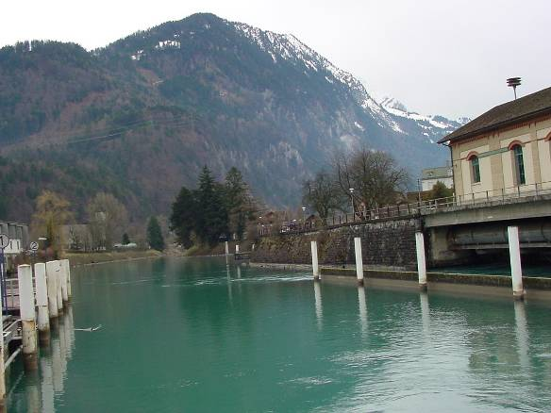
Interlocken, Switzerland

Slide 15
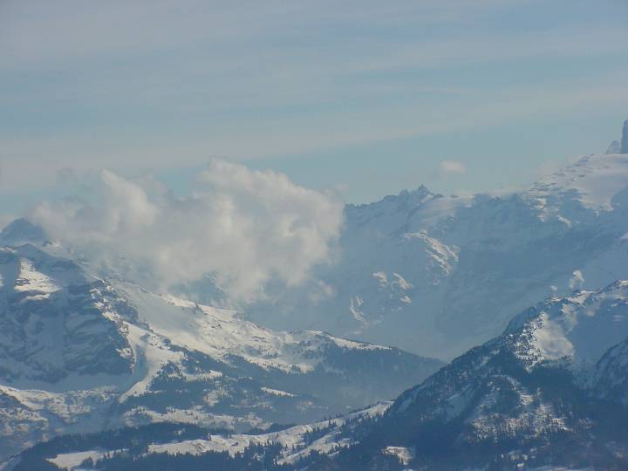
The Alps

Slide 16
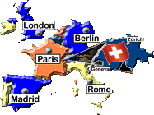
Switzerland’s Neutrality:
The Heart of the Matter

Slide 17
How is this neutral?

Slide 18
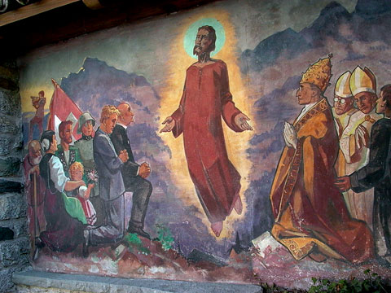
God

Slide 19
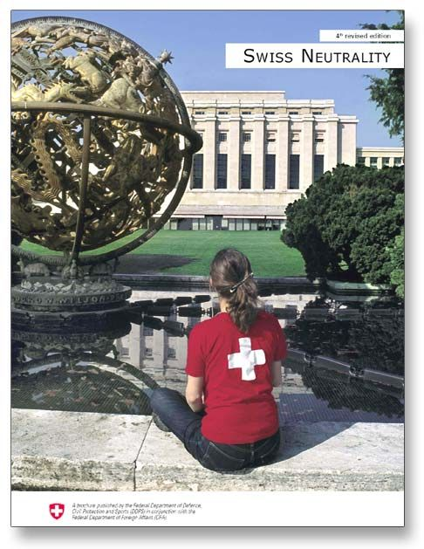
Swiss Neutrality

Slide 20

Swiss Flag

Slide 21

Switzerland’s Global Relations:
The Heart of Peace

Slide 22

"Are Swiss sons to be sacrificed in other people's affairs?"

Slide 23

Swiss stamp 2002

Slide 24

Swiss t-shirt design

Slide 25
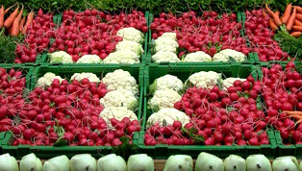
Switzerland: The Heart of the People

Slide 26
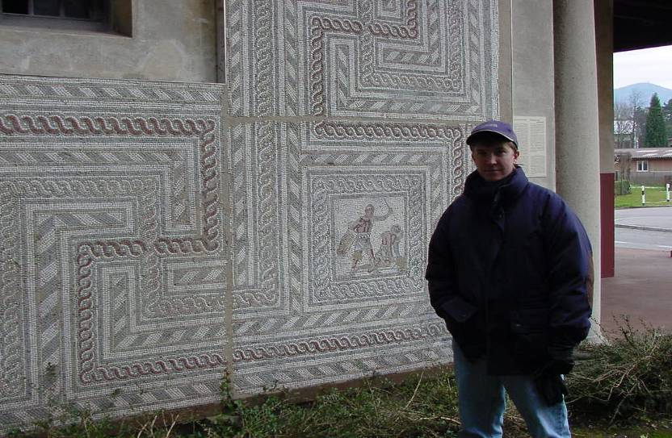
Roman Ruins in Switzerland

Slide 27
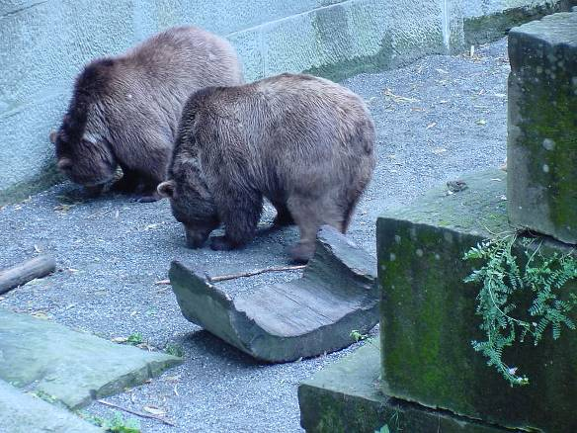
The Bears of Berne

Slide 28
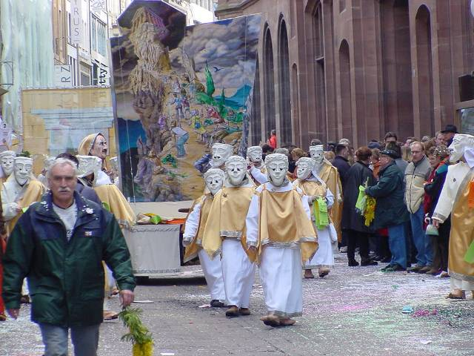
Fasnacht
Drums
Wandering musicians

Slide 29
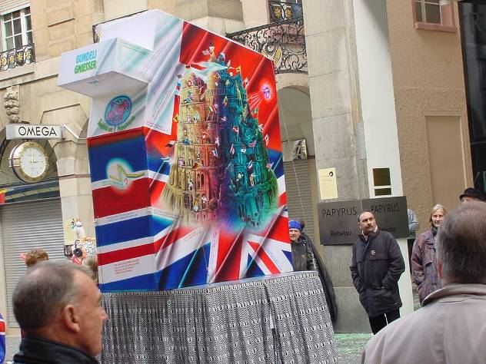
British Lantern

Slide 30
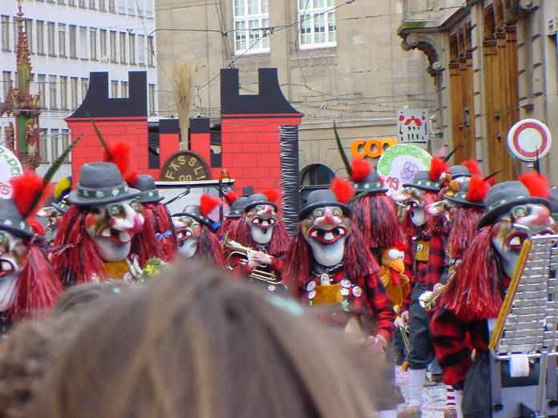
A Clique

